Slide 1
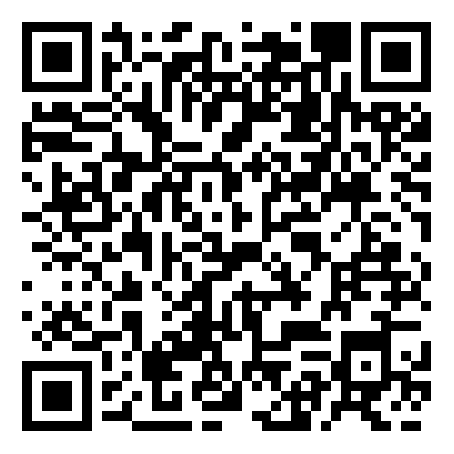
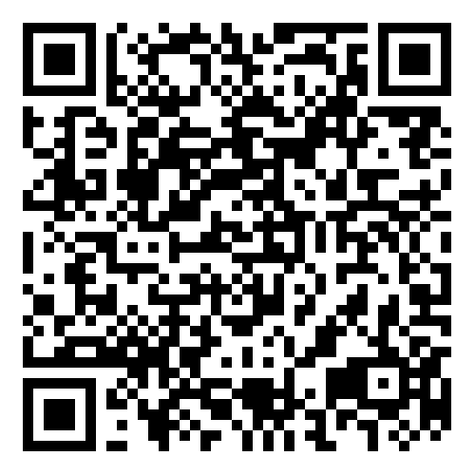
EASE Employee Assistance Programme
Help is just a phone call away with this valuable employee service. Our team of friendly, qualified counsellors and advisors are on hand 24 hours a day, 365 days a year, to offer free and confidential support including emotional, financial and legal guidance.
The Westfield Health EASE programme gives you immediate access to professional help with a whole range of issues, such as:
Stress
Depression
Family difficulties
Medical information
Financial wellbeing
Consumer disputes
Bereavement
Landlord/tenancy
You’ll receive the confidential information and support you might need, when you need it the most. Each telephone session can last up to an hour.
Your telephone counsellor will arrange structured counselling sessions if they think that it would benefit you. This service covers the cost of up to 6 sessions in a 12-month period. These sessions can be delivered face to face, as structured telephone calls or online and may be Cognitive Behavioural Therapy (CBT) technique sessions.
You also have access to wellbeing resources via the Wisdom app, to help overcome life’s wellbeing challenges. You can specify your health and wellbeing preferences to populate a personalised newsfeed with tailored resources, tools and learning materials.
You can also dial through to the helpline, request a call back or Live Agent instant chat with one of the team.
Worried about something? Need some expert advice?
How do I access this service?
Call 0800 092 0987 and quote your scheme number – XXXXX. Available 24 hours a day, 365 days a year. Please note call charges may apply. This does not in any way identify you as an individual, and no personal information relating to your call will be released to your employer. Your family can’t use this service.
To access the mobile app
Download: Wisdom, available on the Apple App Store and Google Play.
Or visit: wisdom.healthassured.org
Use code WHEASE to register
This is a confidential service and the content of your consultations will not be divulged unless there is a serious risk to you or someone else. Calls are not recorded. This is not an emergency service and will not provide diagnosis or prescribe treatments. This service cannot give advice on employment disputes. The 24hr Advice and Information Line and counselling sessions are provided by Westfield Health in conjunction with Health Assured. If you are referred for face to face counselling, you will need to travel at your own expense to the nearest available Health Assured associate counsellor/therapist: you may be required to travel further to access CBT or counselling to meet any special requirement. Counselling sessions can be accessed over the phone or online.
Westfield Health is a trading name of Westfield Health & Wellbeing Ltd and is registered in England & Wales company number 9871093. Westfield Health is a registered trademark.

