Slide 1
EASE Employee Assistance Programme
Help is just a phone call away with this valuable employee service. Our team of friendly, qualified counsellors and advisors are on hand 24/7, 365 to offer free and confidential support including emotional, financial and legal guidance.
Freephone telephone advice and information line available 24 hours a day, 365 days of the year.
Up to six sessions of structured counselling, which can include Cognitive Behavioural Therapy (CBT) technique sessions.
Access to the Wisdom app with information to help overcome life’s wellbeing challenges.
Expert information on issues such as stress, family difficulties, money, bereavement, tenancy, depression and more.
See overleaf for more information on the services and how to access them.
Available 24/7

Slide 2
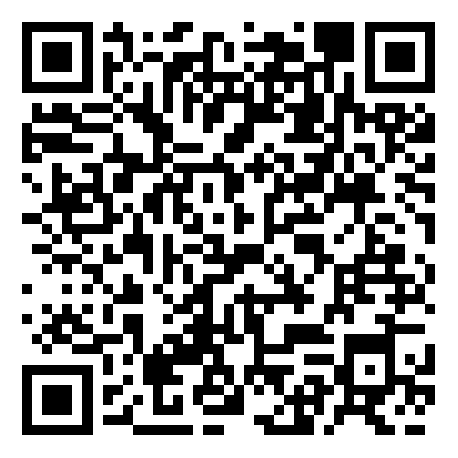
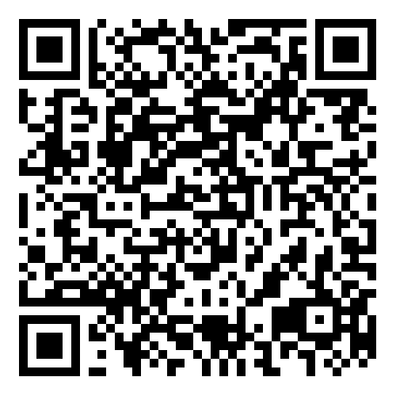
What’s included?
Helping you when it really matters.
Telephone counsellors
Speak to our team of fully trained counsellors 24/7 about issues such as stress, anxiety, depression, family, bereavements, relationships or money management. Each telephone session can last up to an hour.
Structured counselling sessions
If the counsellor thinks it would be beneficial, they can arrange for you to have up to six sessions of structured counselling. They can take place in face to face, over the phone or online.
Help with health and wellbeing
Our team of trained nurses can help with a wide range of issues, including:
Pre-travel advice
Baby and child development
Medical and surgical treatments
Sexual health
Patient rights
Stopping smoking
Reducing alcohol consumption
Diet and exercise
Legal information
Getting the right legal information at the right time from an experienced legal advisor on a wide range of issues, such as:
Consumer disputes
Property
Motoring
Landlord/Tenancy
Debt
Welfare benefits
Matrimonial
Family
Wills and probate
Wisdom
The Wisdom app gives you access to interactive wellbeing tools and features, with access to the helpline via phone or live chat. Download the ‘Wisdom’ app on iOS and Android – enter code WHEASE.
Freephone 0800 092 0987 and quote scheme number 72114
Westfield Health is a trading name of Westfield Health & Wellbeing Ltd and is registered in England & Wales company number 9871093. Westfield Health is a registered trademark.

