Slide 1
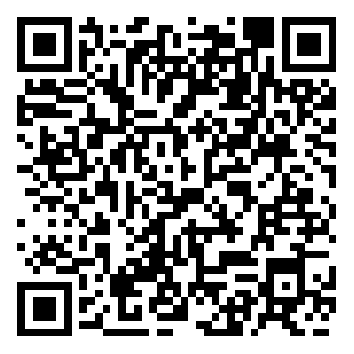
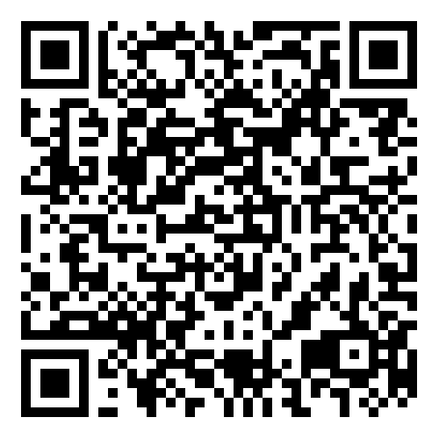
EASE – Employee Assistance Programme
Whatever the issue, support and advice is just a phone call away with this 24/7 freephone service.
Confidential guidance from professionals
Qualified counsellors, legal advisors and nurses are ready to help with anything from stress, bereavement or relationship advice to health and money worries.
Counselling sessions
If required, receive up to 6 sessions in a 12-month period, delivered face to face, as structured telephone calls or online.
Access to online wellbeing resources with the Wisdom app
Download the ‘Wisdom’ app for iOS or Android or visit wisdom.healthassured.org and register with code WHEASE.
Call 0800 092 0987 and quote reference XXXXXX
Westfield Health is a trading name of Westfield Health & Wellbeing Ltd and is registered in England & Wales company number 9871093. Westfield Health is a registered trademark.

