Slide 1
Introducing Healthy Extras

Slide 2
Healthy Extras
Combining key services to ensure you have telephone or online access to professional help to support your wellbeing.
Included services: DELETE THE SERVICES AND SLIDES DEPENDING ON PLAN
DoctorLine 24/7 telephone access to a practising UK GP.
Togetherall A safe online space to get the support you need, in confidence.
24 Hour Advice & Information Line Confidential guidance on medical, legal or domestic issues.
Westfield Rewards Discounts and special offers at hundreds of retailers, restaurants and destinations.
Eldercare Advice A Telephone Care Advisory Service for support with caring responsibilities.
Structured Counselling Up to six sessions of structured counselling in a 12-month period.
Gym Discounts Save on membership at nearby gyms, health clubs and leisure centres, as well as discounted online.

Slide 3
DoctorLine
Unlimited 24/7 telephone access to qualified practising UK GPs and clinical pharmacists:
Call worldwide
Webcam appointments available
Arrange appointments and access health and wellbeing advice through the web app
Have prescription medicines sent to a home, workplace or nearby pharmacy
Call 24/7

Slide 4
DoctorLine

Slide 5
Togetherall
24/7 support
Togetherall is a safe online space to explore things that are troubling you and get support in confidence.
24/7 anonymous support
Share your experiences with other members of the online community
Express yourself in words or images
Browse a library of information and follow courses on topics including managing anxiety, positive thinking and problem solving

Slide 6
Togetherall
Notes:
What do you get?
Access to an exclusive rewards website
Enjoy special offers at over 1000 leading high street and online retailers
Average order is £120
Savings from big brands like M&S, Sainsbury’s, Boots, B&Q, Debenhams and many more
Save £100's a year on the things you buy every day, as well as those larger purchases
Pick up exclusive discounts by purchasing reloadable cards for high street stores and supermarkets
Receive CashBack from participating retailers by shopping online
Many offers are in addition to sale prices, money off vouchers and online promotions
Offers are subject to change

Slide 7
24 Hour Advice and Information Line and online resources
Freephone telephone access to confidential guidance on medical, legal or domestic issues from qualified counsellors, legal advisors and nurses
Access to the Wisdom app with online resources, designed to support your health and wellbeing
Call the freephone line 24/7

Slide 8
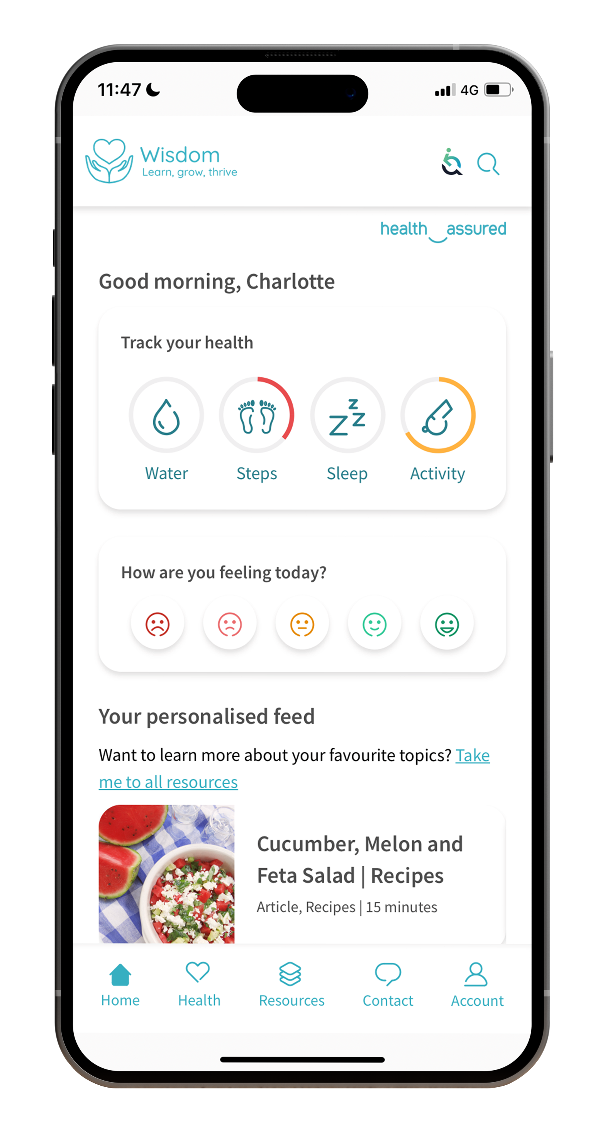
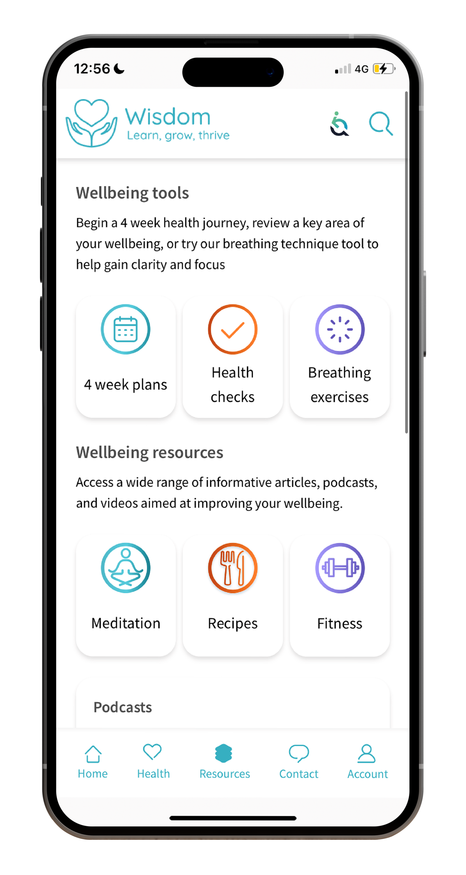
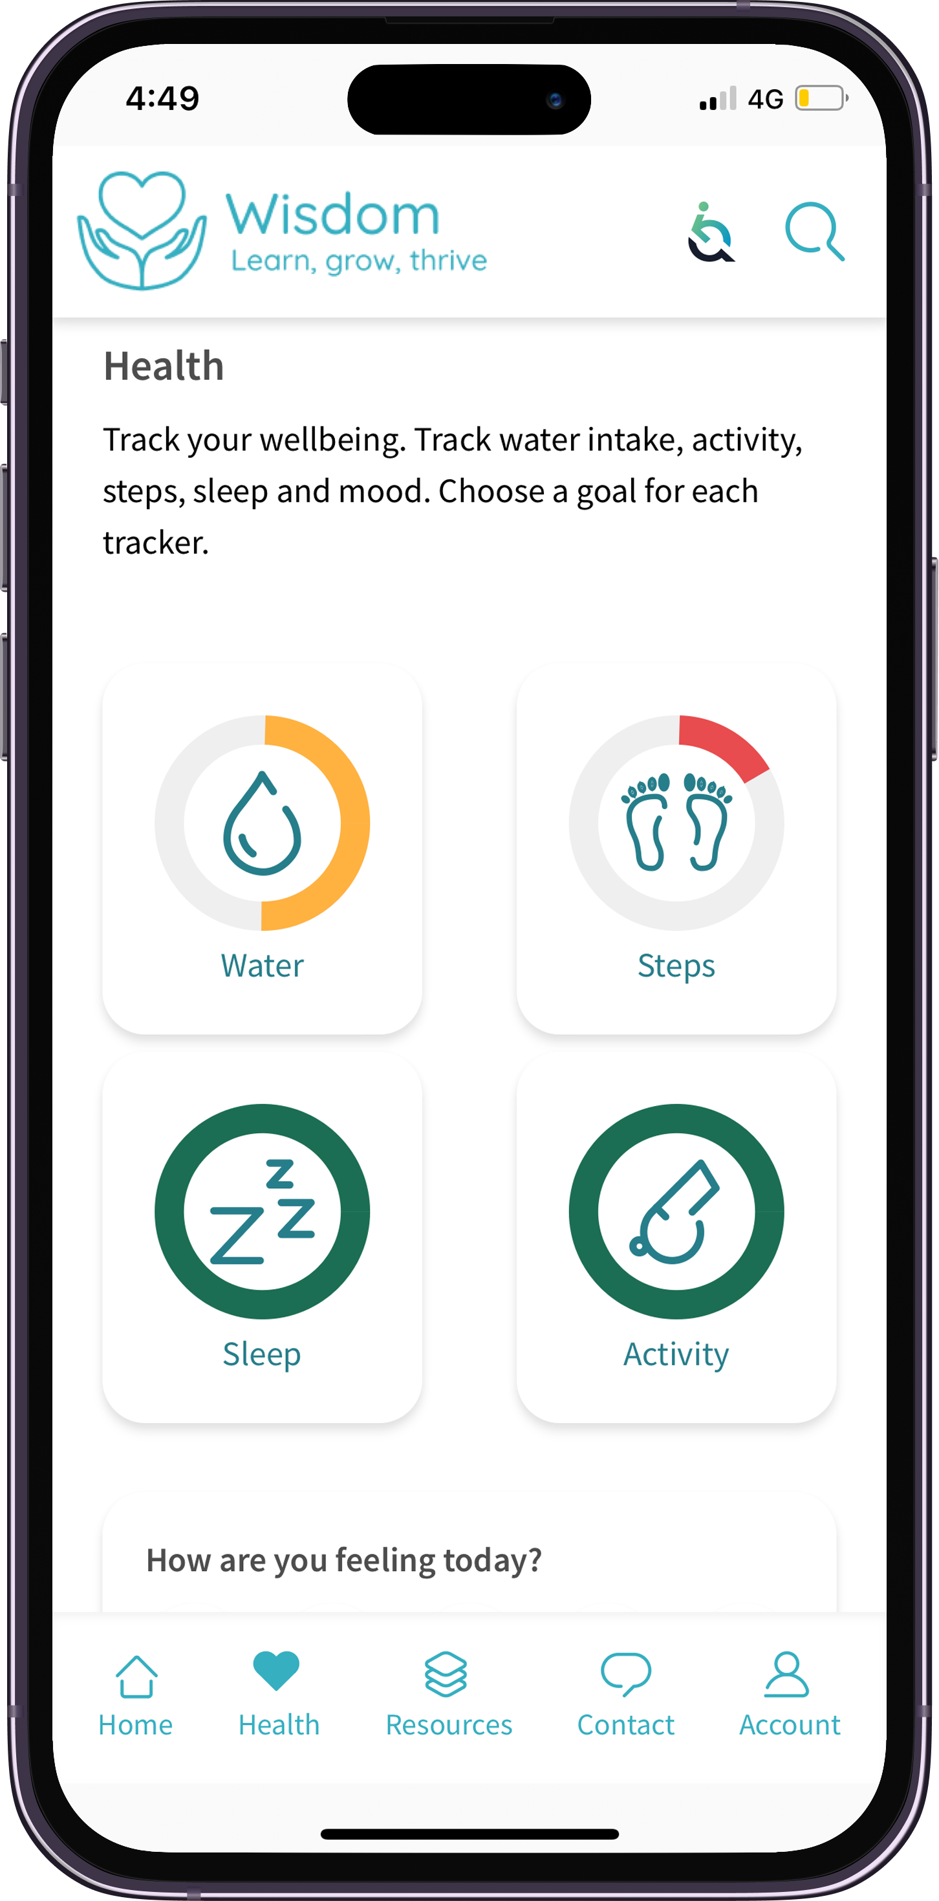
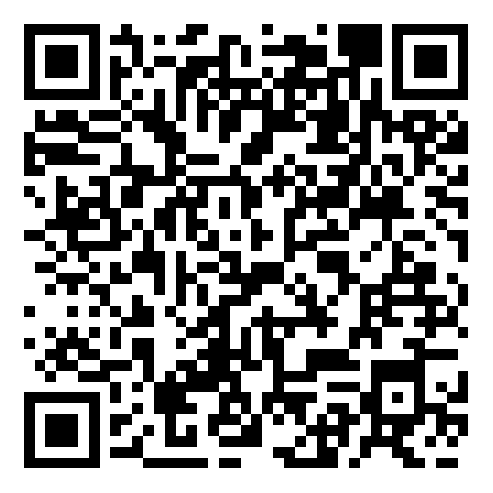
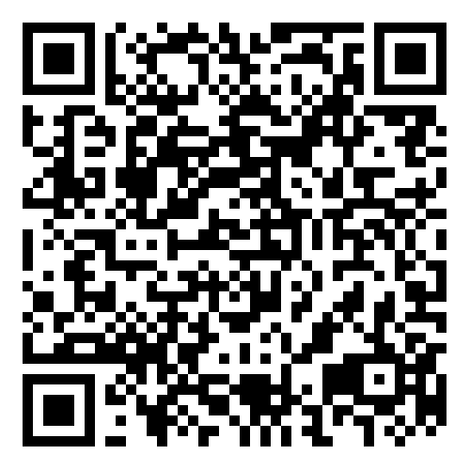
Wisdom
The Wisdom app gives you access to a range of interactive tools and features, helping you track your wellness, improve your mental health and stay resilient during tough times, including:
Live chat and support
Personalised homepage
Interactive mood tracker
Wellbeing trackers
Four-week health plans
Mini health checks
Breathing techniques

Slide 9
Structured Counselling
Up to 6 sessions
With the 24 hour Advice and Information line, you have the option to have up to 6 sessions of structured counselling:
If recommended by the telephone counsellor
Face-to-face, over the phone or video call
Could be Cognitive Behavioural Therapy

Slide 10
Westfield Rewards
Discounts at 100s of retailers
Helping your money go further.
Discounts and offers at hundreds of leading online and high street retailers, restaurants and destinations
Offers change regularly so check the website or ‘Smart Spending’ mobile app for the latest discounts
www.westfieldrewards.co.uk

Slide 11
Westfield Rewards video
Notes:
What do you get?
Access to an exclusive rewards website
Enjoy special offers at over 1000 leading high street and online retailers
Average order is £120
Savings from big brands like M&S, Sainsbury’s, Boots, B&Q, Debenhams and many more
Save £100's a year on the things you buy every day, as well as those larger purchases
Pick up exclusive discounts by purchasing reloadable cards for high street stores and supermarkets
Receive CashBack from participating retailers by shopping online
Many offers are in addition to sale prices, money off vouchers and online promotions
Offers are subject to change

Slide 12
Eldercare Advice
The Telephone Care Advisory Service can help you make informed care choices for yourself and elderly relatives.
Support and advice includes:
Navigate NHS/Private residential and home care choices
Resolving care issues
Research care providers
Practical and emotional support for your caring responsibilities
Telephone advice

Slide 13
Gym Discounts
You can save up to 40% on membership at nearby gyms, health clubs and leisure centres, as well as discounted online workout subscriptions.
What’s included:
Choose from over 4,000 gyms, yoga or Pilates studios, bootcamps or leisure centres across the UK
Multi-activity membership options
Kickstart your fitness

Slide 14
Accessing the services
DoctorLine
Call: 0345 319 3991
Use code: 72115
24 Hour Advice and Information Line
Call: 0800 092 0987
Quote Reference: 72115
Wisdom
Download the app on iOS and Android or visit wisdom.healthassured.org
Use code WHNI to register
Westfield Rewards
Sign up via My Westfield
Togetherall
Visit: togetherall.com/joinnow/westfieldhealth

Slide 15
Accessing the services
Eldercare Advice
Call: 0114 303 1060
Quote Reference: XXXX
Gym Discounts
Access via My Westfield
Structured Counselling
The telephone counsellor will arrange the sessions if they think that it will be of benefit.
Call: 0800 092 0987
Quote Reference: XXXX

Slide 16
My Westfield
You can register for My Westfield to:
View your plan documents
Access all your services
westfieldhealth.com/my-westfield
Download the mobile app on the Apple App Store or Google Play

Slide 17
Thank you
Westfield House
60 Charter Row
Sheffield
S1 3FZ
0114 250 2000
www.westfieldhealth.com
Westfield Health is a trading name of Westfield Health & Wellbeing Ltd and is registered in England & Wales company number 9871093.
Westfield Health is a registered trademark.

