Slide 1
Introducing
your cover
Chamber Primary Health Cash Plan

Slide 2
What is a health cash plan?
A health cash plan allows you to claim money back, up to set limits, towards the cost of your essential healthcare, as well as providing access to valuable health and wellbeing services.

Slide 3
Chamber Primary Health Cash Plan
Money back towards your essential health bills
One year benefit periods with 100% reimbursement, up to set limits
Health & wellbeing services
Voluntary upgrades and partner cover available

Slide 4
Key features
No medical required before joining
No waiting period
No limit on number of claims, up to limits of your cover level
Pre-existing medical conditions covered for all eligible employees
Some worldwide cover available
Dependent children covered on key benefits at no extra cost

Slide 5
How to claim
1.
Pay for your treatment as normal and remember to keep hold of the receipt
2.
Submit your claim online with a picture of your receipt, or send it through the post
3.
We’ll process online claims within 2 working days and pay the money straight into your account

Slide 6
Health and wellbeing services
As well as cashback, you have access to valuable health and wellbeing services:
24 Hour Advice and Information Line – confidential guidance on medical, legal or domestic issues, with online resources
DoctorLine – 24/7 telephone access to a practising UK GP
Expert Medical Opinion/Best Doctors – An expert second medical opinion from a world leading specialist
Westfield Rewards – Discounts and special offers at hundreds of retailers, restaurants and destinations
Gym Discounts – Discounted memberships at local gyms

Slide 7
Chamber Primary Health Cash Plan
Level | Level 1 | Level 2 | Level 3 | Level 4
Money back on everyday health plus fitness and retail discounts
Optical For you | Up to £55 | Up to £105 | Up to £180 | Up to £220
Dental For you | Up to £55 | Up to £105 | Up to £180 | Up to £220
Dental Accident For you | Up to £110 | Up to £210 | Up to £360 | Up to £440
Chiropody For you | Up to £25 | Up to £50 | Up to £75 | Up to £100
Specialist Consultations and Diagnostics For you | Up to £200 | Up to £400 | Up to £600 | Up to £700
Therapy Treatments For you: Physiotherapy, Acupuncture, Chiropractic, Homeopathy, Osteopathy | Up to £150 | Up to £250 | Up to £500 | Up to £650
Westfield Rewards For you
Fast access to diagnosis and treatment for body and mind
Scanning Service - MRI, CT & PET Scans For you
DoctorLine For you, your partner and dependent children
Expert Medical Opinion/Best Doctors For you, your partner and dependent children
24 Hour Advice and Information Line including the Wisdom app For you, your partner and your children: counselling, legal, health and wellbeing advice, online resources Including up to six sessions of structured counselling For you
Gym Discounts For you
Personal Accident/Accidental Death For you | £5,000 | £10,000 | £15,000 | £20,000
Personal Accident/Permanent Disability For you | Up to £5,000 | Up to £10,000 | Up to £15,000 | Up to £20,000
100
1yr
100
1yr
100
1yr
Key
1yr
1 year benefit period
100
1yr
100
100% money back
100
1yr
1yr
1yr
1yr
100
1yr
Following a referral from a Consultant, you must call our Scanning Helpline on 0345 345 4556 and they will arrange the scan. Please see Benefit Rules for more information.

Slide 8
Kids’ cover
Level | Level 1 | Level 2 | Level 3 | Level 4
Money Back – Shared between dependent children
Optical | Up to £55 | Up to £105 | Up to £180 | Up to £220
Dental | Up to £55 | Up to £105 | Up to £180 | Up to £220
Dental Accident | Up to £110 | Up to £210 | Up to £360 | Up to £440
Specialist Consultations and Diagnostics | Up to £200 | Up to £400 | Up to £600 | Up to £700
Therapy Treatments Physiotherapy, Acupuncture, Chiropractic, Homeopathy, Osteopathy | Up to £150 | Up to £250 | Up to £500 | Up to £650
100
1yr
Key
1yr
1 year benefit period
100
1yr
100
100% money back
100
1yr
100
1yr
100
1yr
Your dependent children can receive cash benefits towards their essential health expenses.
100% reimbursement on cash benefits, up to set limits
Your children’s pre-existing medical conditions are covered
Immediate cover

Slide 9
Your benefits in detail

Slide 10
Optical
Claim 100% cost, up to set limits
Helps cover the cost of routine optical care including:
Eye tests
Prescription glasses
Prescription sunglasses
Contact lenses & solutions for prescribed contact lenses
Prescription swimming and safety goggles
Repairs to prescription glasses

Slide 11
Dental
Claim 100% cost, up to set limits
Helps cover the cost of routine dental healthcare including:
Check ups
Fillings
Scale and polish
Technicians’ fees
Full or partial dentures
Excludes cosmetic

Slide 12
Dental Accident
Covers dental treatment carried out as a result of accidental injury to teeth, caused by direct impact to the head, including:
Chipped tooth
Tooth fractures
Tooth knocked loose
Tooth jammed into socket
Tooth knocked out
Claim 100% cost, up to set limits

Slide 13
Chiropody
Claim 100% cost, up to set limits
Helps cover the cost of treatment and advice provided by a qualified Chiropodist/ Podiatrist.
Claim for issues including:
Toenail problems
Verrucas, corns and calluses
Athlete's foot
Dry and cracked heels
Bunions
Or just general advice

Slide 14
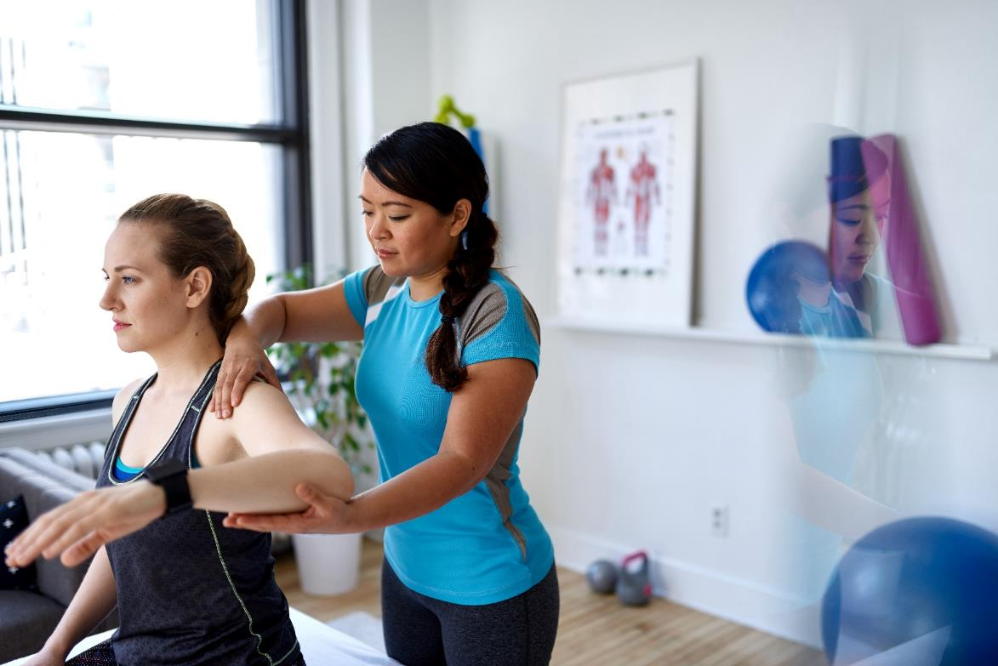
Therapy Treatments
Claim 100% cost, up to set limits
Claim money back for any one or combination of the following treatments, up to set limits:
Physiotherapy
Acupuncture
Chiropractic
Homeopathy
Osteopathy

Slide 15
Specialist Consultations and Diagnostics
Claim money back, up to your plan limits, on visits to private consultants, when referred by your Medical Professional:
Get seen more quickly
More choice of doctors
Claim 100% cost, up to set limits

Slide 16
Westfield Rewards
Available on all levels
Helping your money go further.
Discounts and offers at hundreds of leading online and high street retailers, restaurants and destinations
Offers change regularly so please check the website or ‘Smart Spending’ mobile app for the latest discounts
www.westfieldrewards.co.uk

Slide 17
Scanning Service
Quick access to high quality MRI, CT and PET scans for fast diagnosis:
Choose the location and time
You'll be looked after by our professional team
MRI and CT scans are unlimited
PET scans are limited to one per 12 month period
Call the scanning helpline following a referral from your consultant

Slide 18
DoctorLine
Unlimited 24/7 telephone access to qualified practising UK GPs:
Call worldwide
Webcam appointments available
Arrange appointments and access health and wellbeing advice through the web app
Have prescription medicines sent to your home, workplace or a nearby pharmacy
Available on all levels

Slide 19
Expert Medical Opinion /Best Doctors
Get a second opinion and peace of mind from a world leading specialist when you’re worried about a medical condition.
Access to 50,000 doctors in over 40 different medical disciplines
Receive a report from an expert to share with your doctor to determine the most effective treatment
100% confidential service
Call the helpline 24 Hours a day

Slide 20
24 Hour Advice and Information Line and online resources
Freephone telephone access to confidential guidance on medical, legal or domestic issues from qualified counsellors, legal advisors and nurses
Access to the Wisdom app with online resources, designed to support your health and wellbeing
Call the freephone line 24/7

Slide 21
Structured Counselling
Available on all levels
Included with the 24 Hour Advice and Information Line is up to 6 sessions of structured counselling:
If recommended by your telephone counsellor
Face-to-face, over the phone or video call
Could be Cognitive Behavioural Therapy

Slide 22
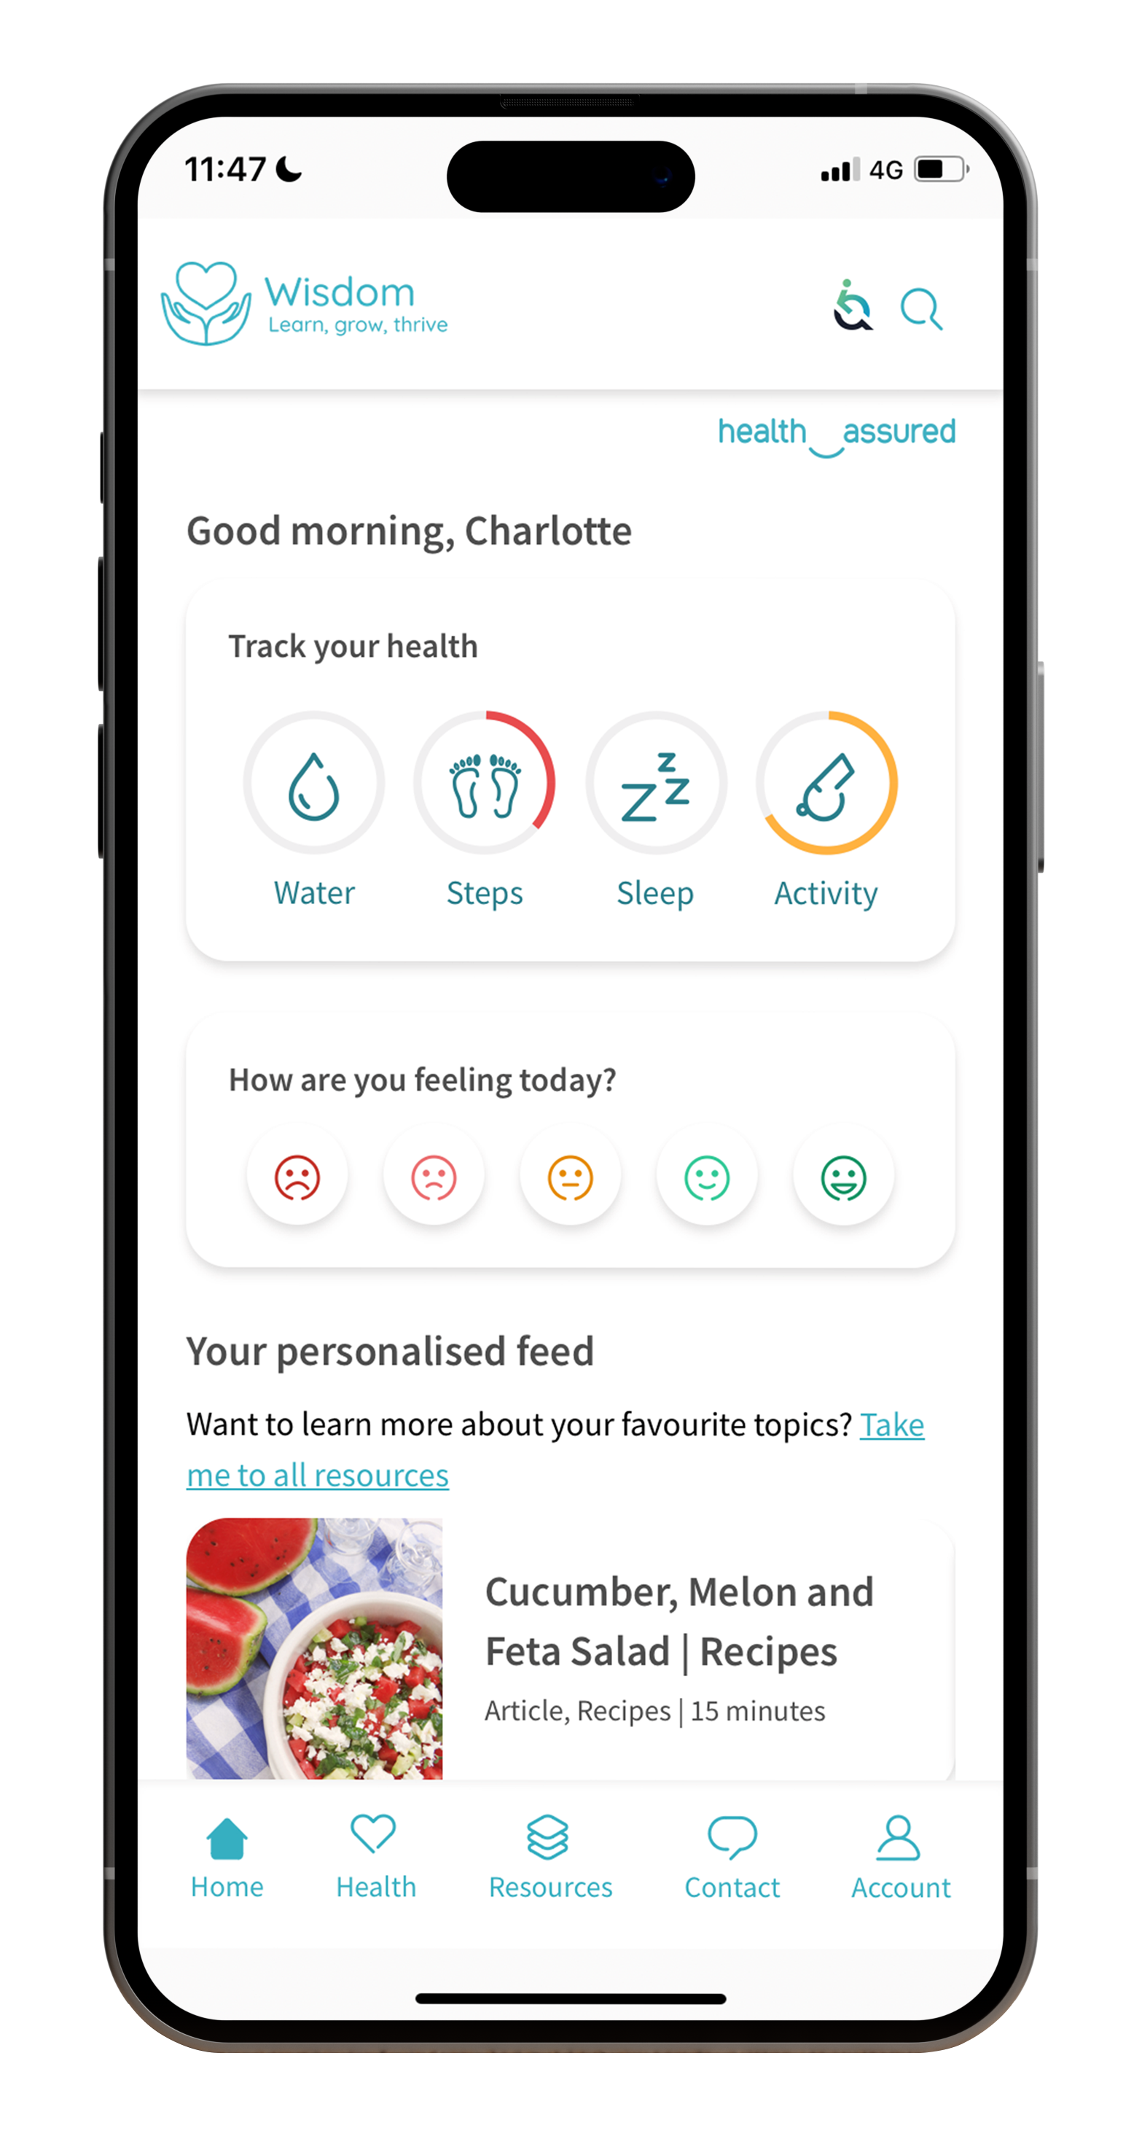
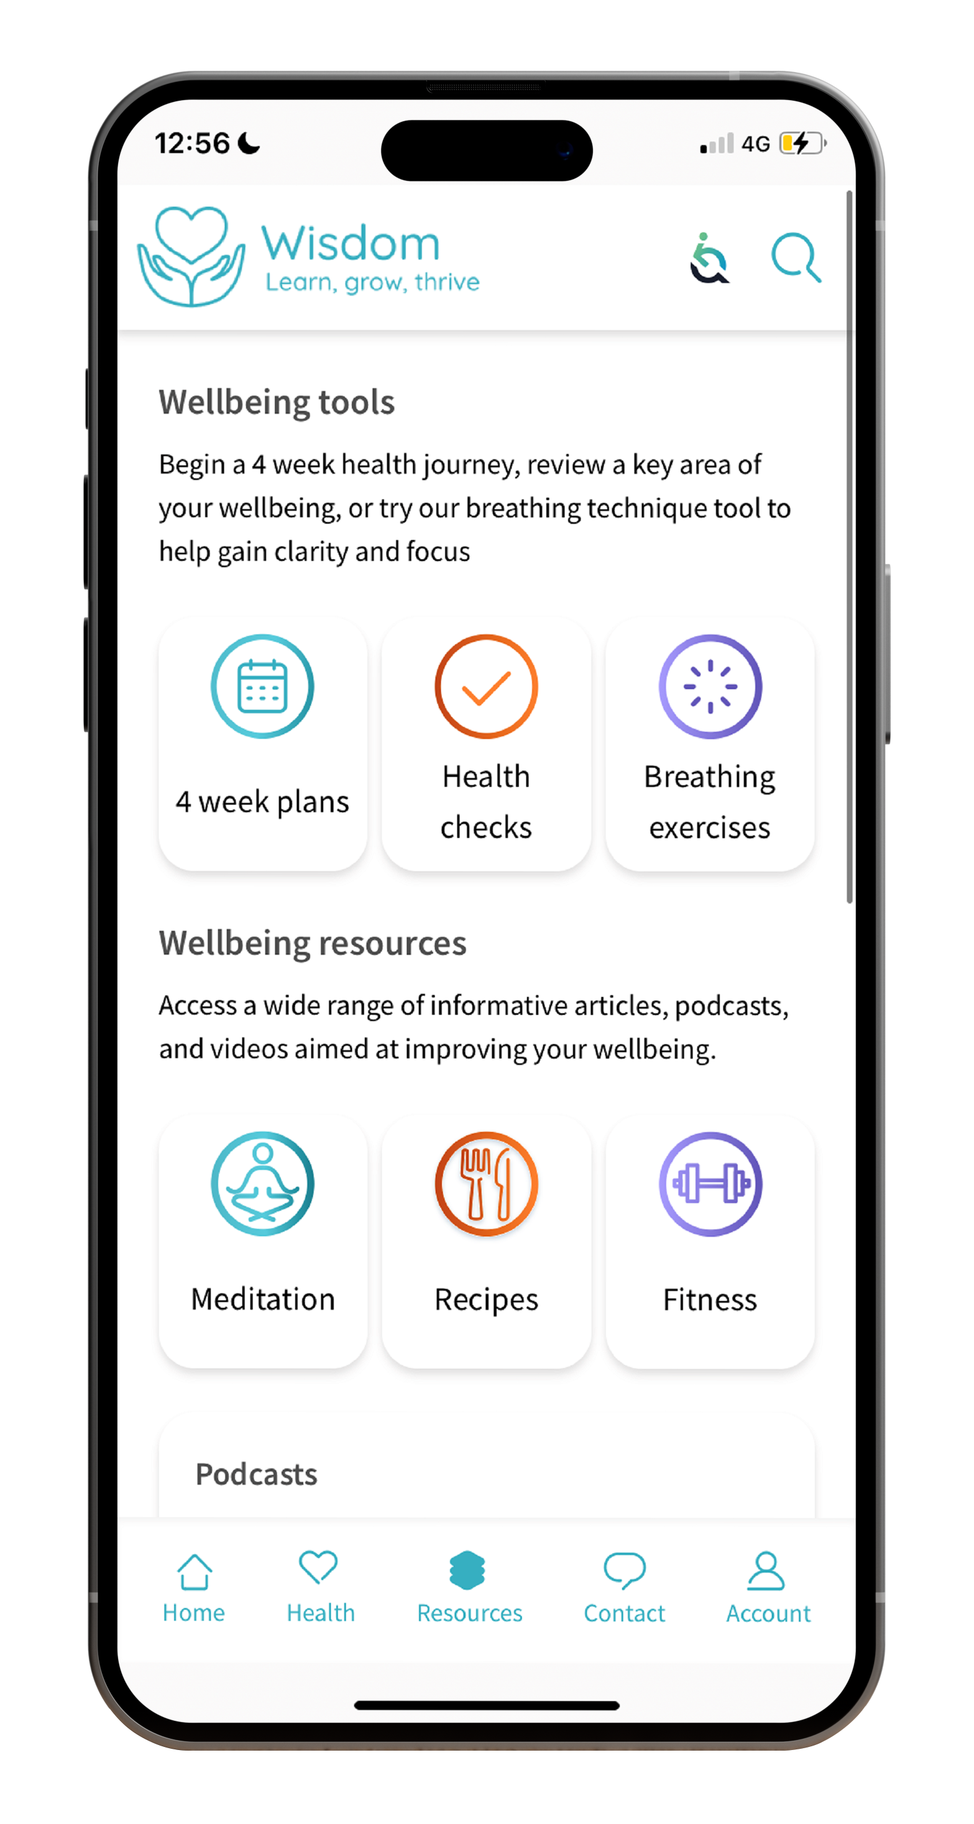
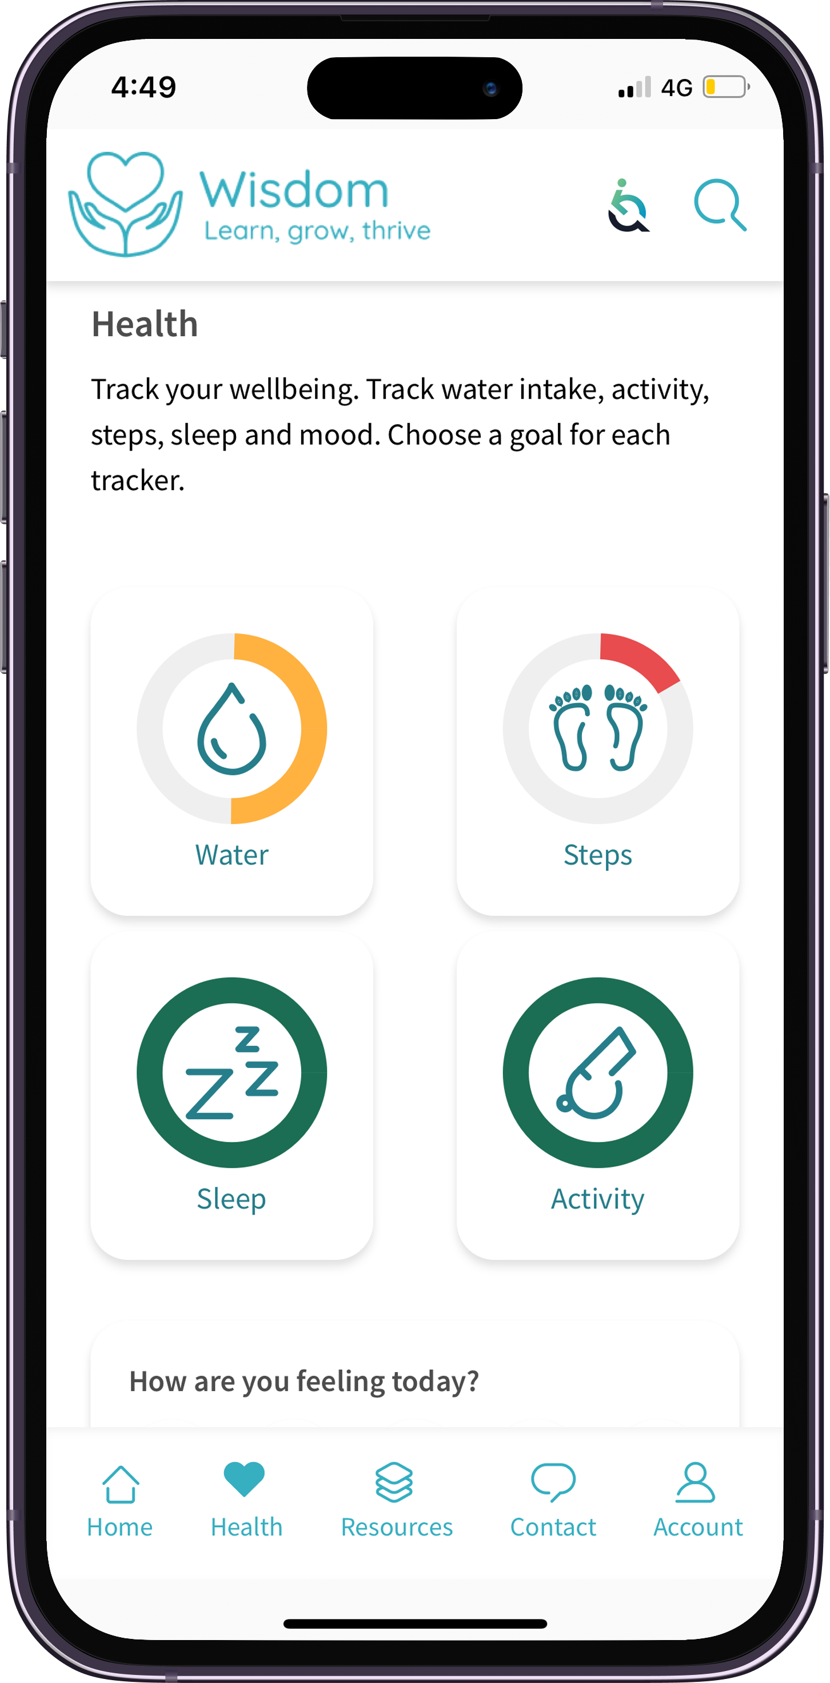
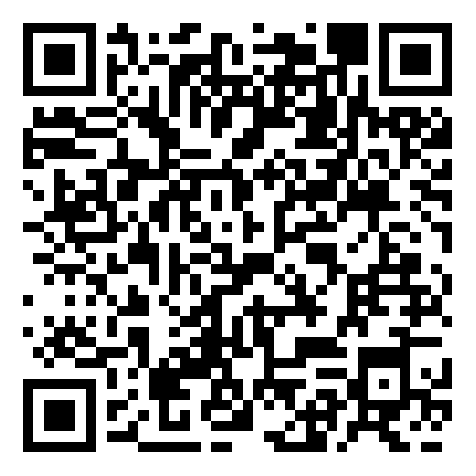
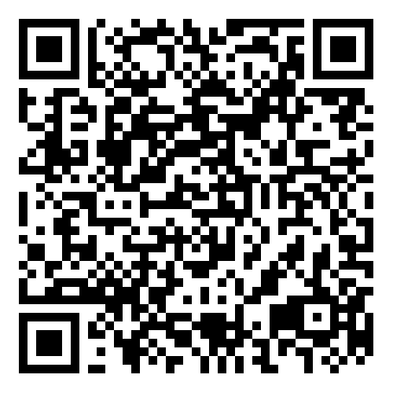
Wisdom
The Wisdom app gives you access to a range of interactive tools and features, helping you track your wellness, improve your mental health and stay resilient during tough times, including:
Live chat and support
Personalised homepage
Interactive mood tracker
Wellbeing trackers
Four-week health plans
Mini health checks
Breathing techniques

Slide 23
Gym Discounts
Discounts at gyms and health clubs in your area, as well as online classes
Current gym members may transfer their existing membership
Offers are updated regularly
Get fit and actively start improving your health!
Available on all levels

Slide 24
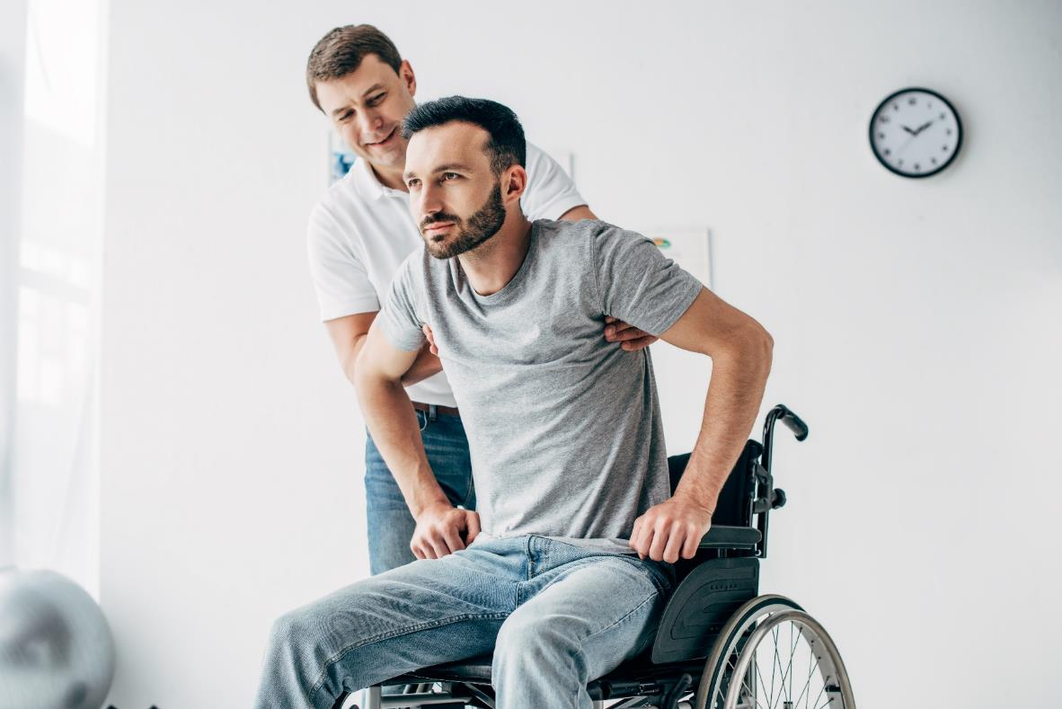
Personal Accident
Available on all levels
Cash payouts to help you and your family if the worst should happen.
Accidental bodily injury that causes your death within 24 months of the time of your accident
Accidental bodily injury that causes your permanent disability within 24 months of the time of your accident

Slide 25
Kids’ cover
If you’re eligible or decide to add kids’ cover yourself, you can claim for your kids up to their 22nd birthday on:
Optical
Dental
Dental Accident
Therapy Treatments
Specialist Consultations and Diagnostics
Benefit limits are shared between all your dependent children.
Available, up to set limits, on all levels

Slide 26
Upgrades and partners
You can choose to upgrade your policy to a higher level or set up a policy for an additional adult during the first month starting from your company’s anniversary date.
Look for the application form in your plan guide.
This table shows upgrade amounts from level 1. Please edit the values if this is different for your client.
 | Level 1 | Level 2 | Level 3 | Level 4
Upgrade | Company Paid | £12.08 | £29.64 | £47.60
Voluntary Partner | £9.42 | £18.82 | £36.38 | £54.34

Slide 27
My Westfield
Register for My Westfield to:
Make a claim
View your plan documents
Manage your account
Access your health and wellbeing services
westfieldhealth.com/my-westfield
Download the mobile app on the Apple App Store or Google Play

Slide 28
Thank you
Westfield House
60 Charter Row
Sheffield
S1 3FZ
0114 250 2000
www.westfieldhealth.com
Westfield Contributory Health Scheme Ltd (company number 303523), Westfield Health & Wellbeing Ltd (company number 9871093) and Westfield Employment Services Ltd (company number 9870326) are collectively referred to as Westfield Health and are registered in England & Wales. Additionally Westfield Contributory Health Scheme Ltd is authorised by the Prudential Regulation Authority and regulated by the Financial Conduct Authority and the Prudential Regulation Authority. Our financial services registration number is 202609.

