Slide 1
Introducing
your cover
Foresight Health Cash Plan

Slide 2
What is a health cash plan?
A health cash plan allows you to claim money back, up to set limits, towards the cost of your essential healthcare, as well as providing access to valuable health and wellbeing services.

Slide 3
Foresight Health Cash Plan
Money back towards your essential health bills
One year benefit periods with 100% reimbursement, up to set limits
Health & wellbeing services
Voluntary upgrades and additional adult cover available

Slide 4
Key features
No medical required before joining
No waiting period
No limit on number of claims, up to limits of your cover level
Pre-existing medical conditions covered for all eligible employees
Some worldwide cover available
Dependent children covered on some benefits at no extra cost

Slide 5
How to claim
1.
Pay for your treatment as normal and remember to keep hold of the receipt
2.
Submit your claim online with a picture of your receipt, or send it through the post
3.
We’ll process online claims within 2 working days and pay the money straight into your account

Slide 6
Health and wellbeing services
As well as cashback, you have access to valuable health and wellbeing services:
24 Hour Advice and Information Line – confidential guidance on medical, legal or domestic issues, with online resources
DoctorLine – 24/7 telephone access to a practising UK GP
Westfield Rewards – Discounts and special offers at hundreds of retailers, restaurants and destinations
Gym Discounts – Discounted memberships at local gyms

Slide 7
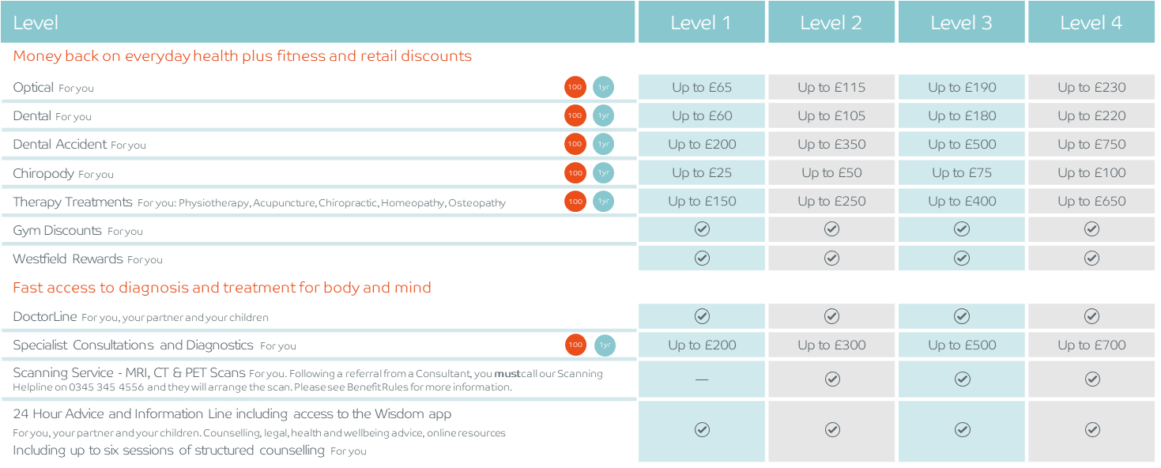
Foresight Health Cash Plan
Key
1yr
1 year benefit period
100
100% money back

Slide 8
Your kids are covered too
Level | Level 1 | Level 2 | Level 3 | Level 4
Money Back – Shared between dependent children
Optical | Up to £32.50 | Up to £57.50 | Up to £95 | Up to £115
Dental | Up to £30 | Up to £52.50 | Up to £90 | Up to £110
Dental Accident | Up to £100 | Up to £175 | Up to £250 | Up to £375
Chiropody | Up to £12.50 | Up to £25 | Up to £37.50 | Up to £50
Therapy Treatments Physiotherapy, Acupuncture, Chiropractic, Homeopathy, Osteopathy | Up to £75 | Up to £125 | Up to £200 | Up to £325
Specialist Consultations and Diagnostics | Up to £100 | Up to £150 | Up to £250 | Up to £350
100
1yr
Key
100
1yr
1yr
1 year benefit period
100
100% money back
100
1yr
100
1yr
100
1yr
100
1yr

Slide 9
Your benefits in detail

Slide 10
Optical
Claim 100% cost, up to set limits
Helps cover the cost of routine optical care including:
Eye tests
Prescription glasses
Prescription sunglasses
Contact lenses & solutions for prescribed contact lenses
Prescription swimming and safety goggles
Repairs to prescription glasses

Slide 11
Dental
Claim 100% cost, up to set limits
Helps cover the cost of routine dental healthcare including:
Check ups
Fillings
Scale and polish
Technicians’ fees
Full or partial dentures
Excludes cosmetic

Slide 12
Dental Accident
Covers dental treatment carried out as a result of accidental injury to teeth, caused by direct impact to the head, including:
Chipped tooth
Tooth fractures
Tooth knocked loose
Tooth jammed into socket
Tooth knocked out
Claim 100% cost, up to set limits

Slide 13
Chiropody
Claim 100% cost, up to set limits
Helps cover the cost of treatment and advice provided by a qualified Chiropodist/ Podiatrist.
Claim for issues including:
Toenail problems
Verrucas, corns and calluses
Athlete's foot
Dry and cracked heels
Bunions
Or just general advice

Slide 14
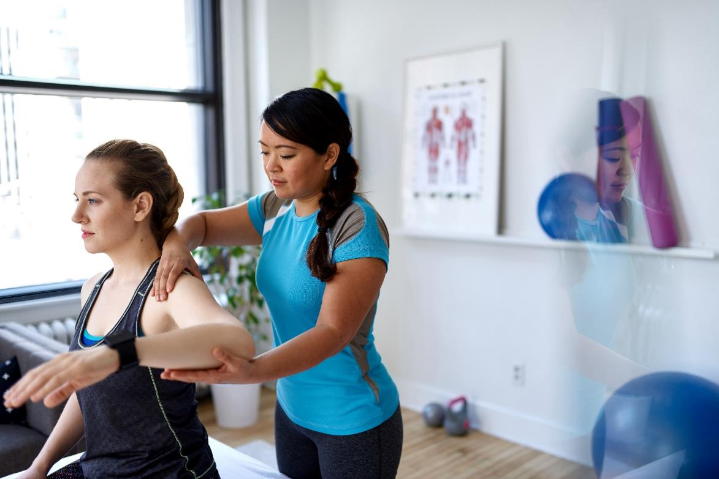
Therapy Treatments
Claim 100% cost, up to set limits
Claim money back for any one or combination of the following treatments, up to set limits:
Physiotherapy
Acupuncture
Chiropractic
Homeopathy
Osteopathy

Slide 15
Gym Discounts
Discounts at gyms and health clubs in your area, as well as online classes
Current gym members may transfer their existing membership
Offers are updated regularly
Get fit and actively start improving your health!
Available on all levels

Slide 16
Westfield Rewards
Available on all levels
Helping your money go further.
Discounts and offers at hundreds of leading online and high street retailers, restaurants and destinations
Offers change regularly so please check the website or ‘Smart Spending’ mobile app for the latest discounts
www.westfieldrewards.co.uk

Slide 17
DoctorLine
Unlimited 24/7 telephone access to qualified practising UK GPs:
Call worldwide
Webcam appointments available
Arrange appointments and access health and wellbeing advice through the web app
Have prescription medicines sent to your home, workplace or a nearby pharmacy
Available on all levels

Slide 18
Specialist Consultations and Diagnostics
Claim money back, up to your plan limits, on visits to private consultants, when referred by your Medical Professional:
Get seen more quickly
More choice of doctors
Claim 100% cost, up to set limits

Slide 19
Scanning Service
Quick access to high quality MRI, CT and PET scans for fast diagnosis, available on levels 2-4:
Choose the location and time
You'll be looked after by our professional team
MRI and CT scans are unlimited
PET scans are limited to one per 12 month period
Call the scanning helpline following a referral from your consultant

Slide 20
24 Hour Advice and Information Line and online resources
Freephone telephone access to confidential guidance on medical, legal or domestic issues from qualified counsellors, legal advisors and nurses.
Access to the Wisdom app which includes mood trackers, four-week plans, mini health checks, webinars and more.
Call the freephone line 24/7

Slide 21
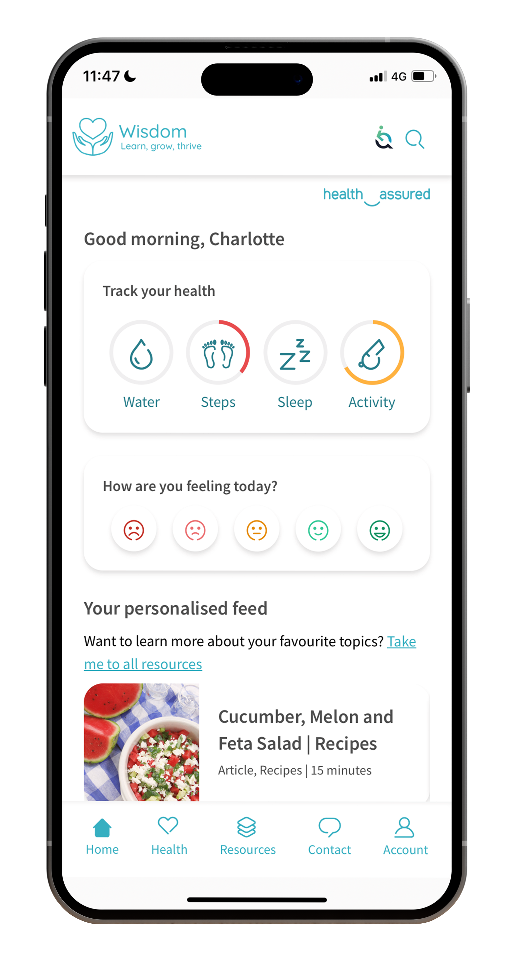
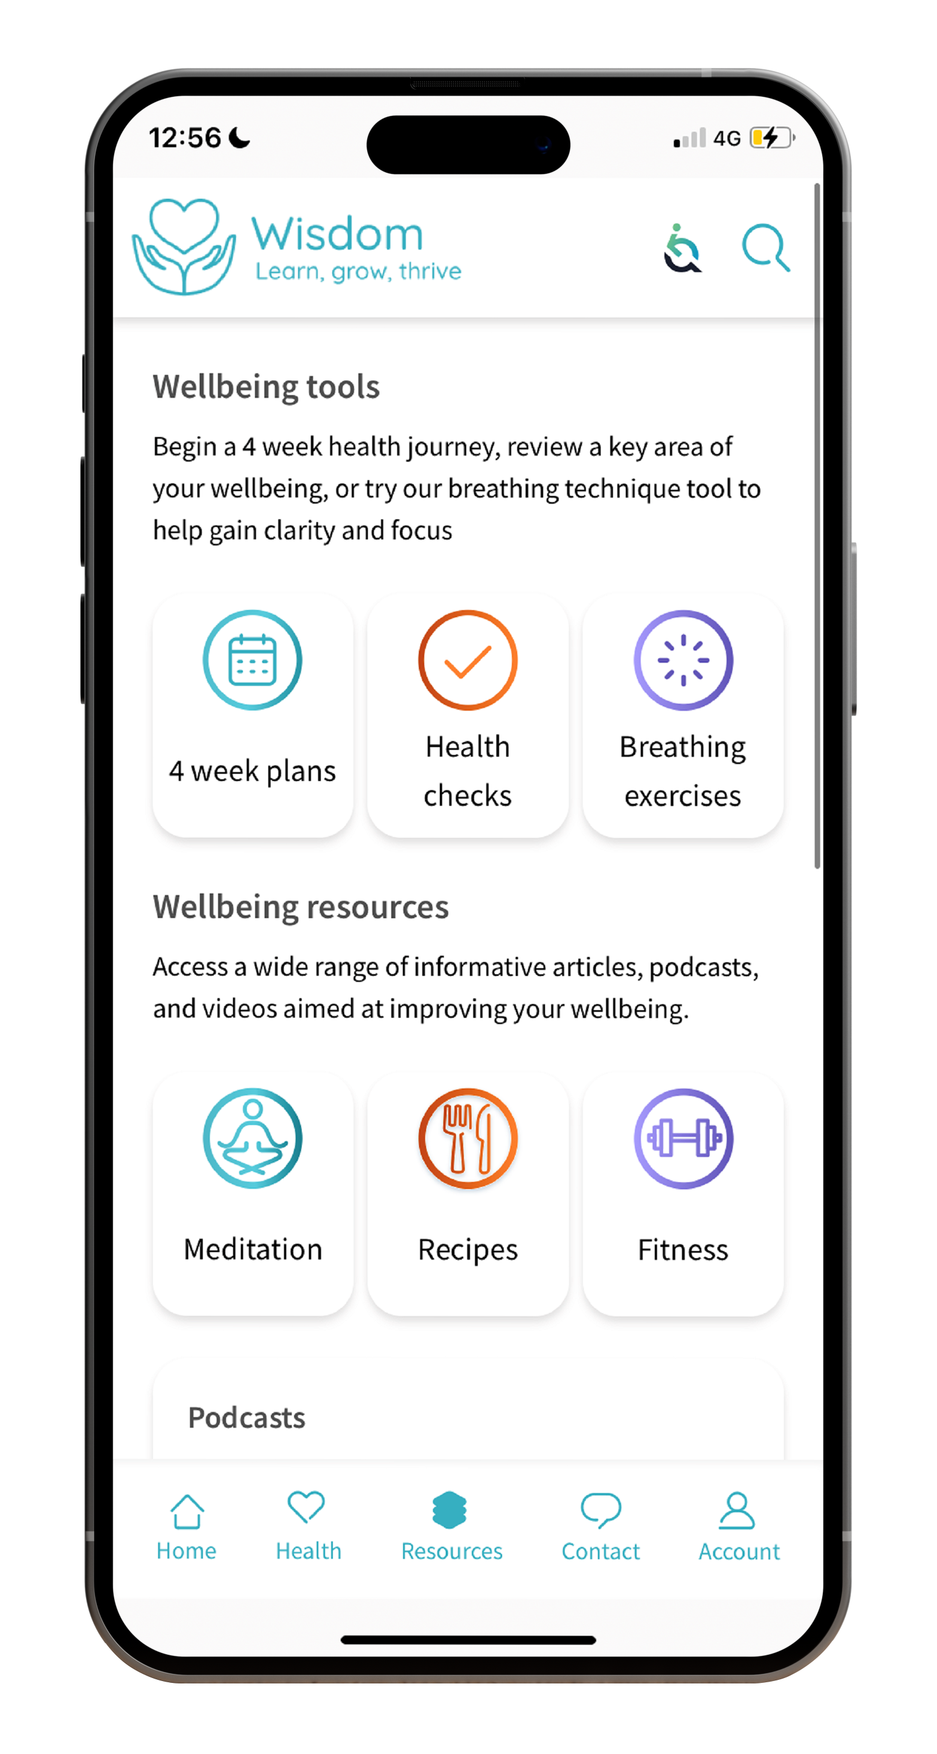
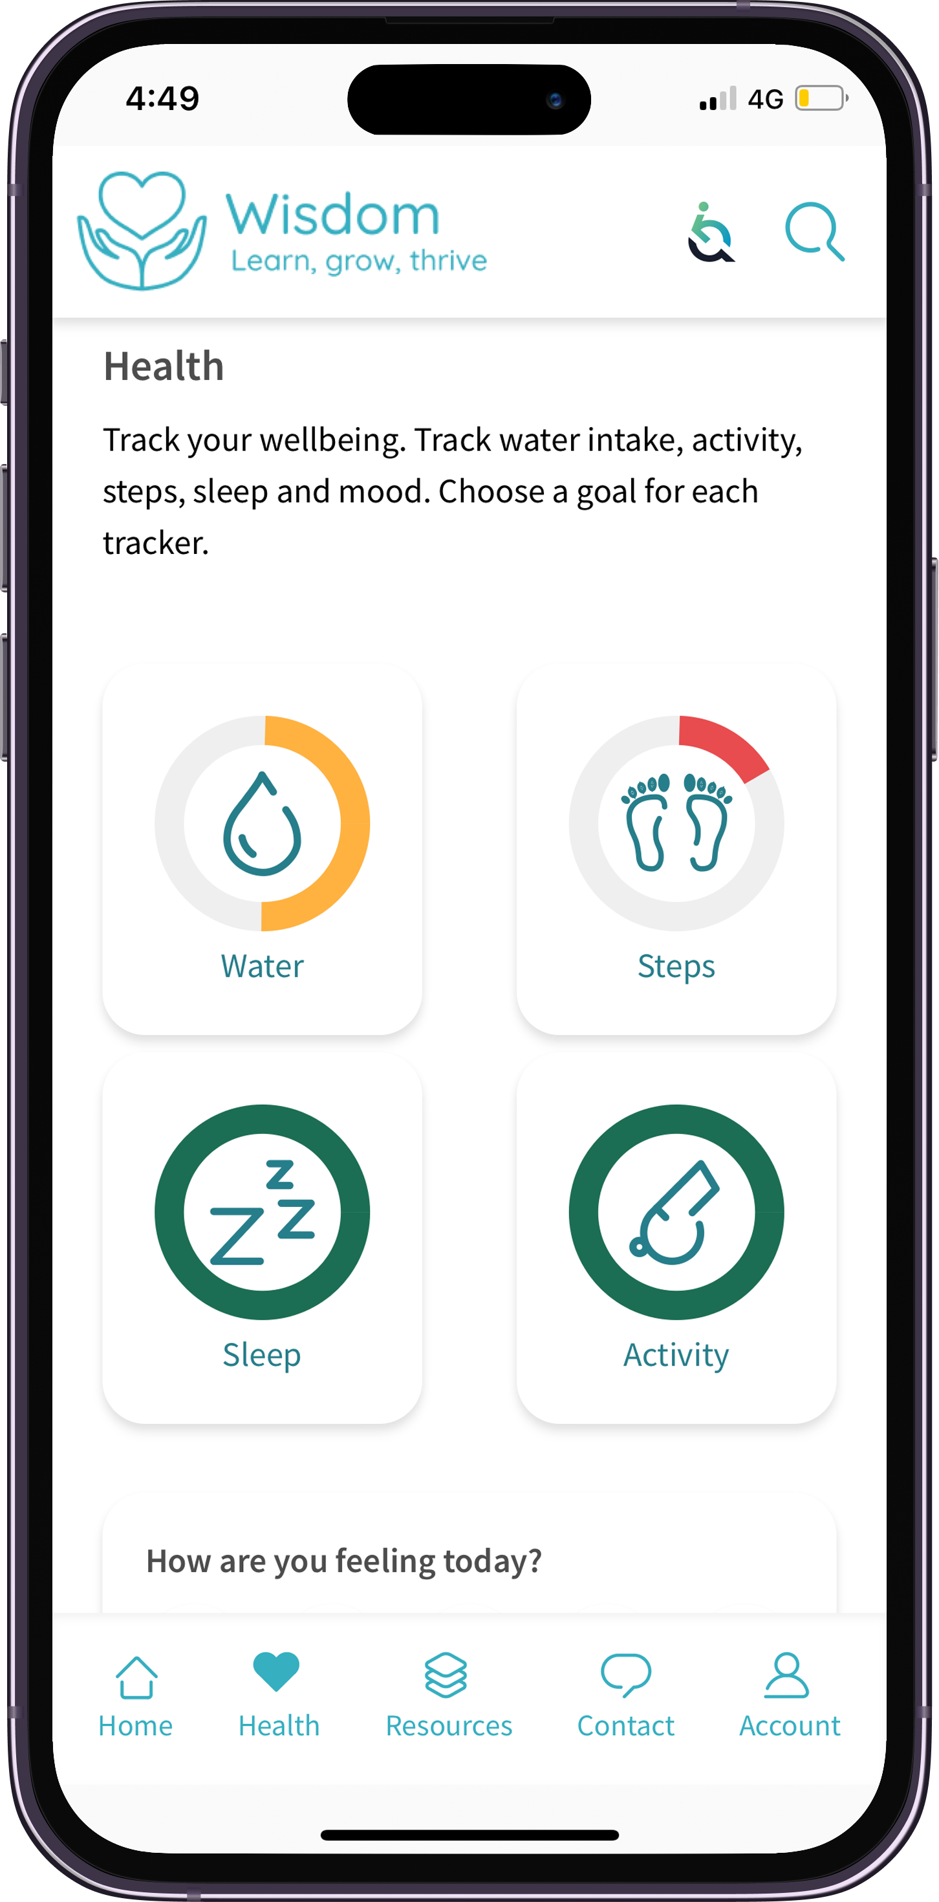
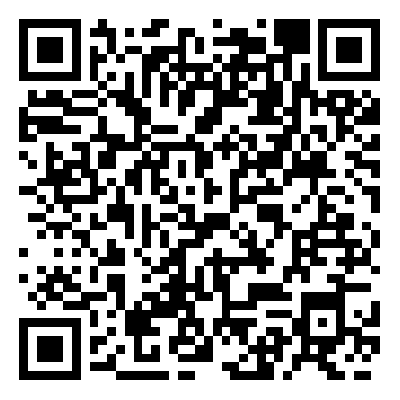
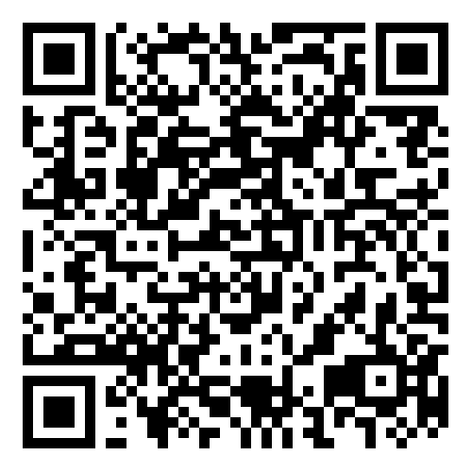
Wisdom
The Wisdom app gives you access to a range of interactive tools and features, helping you track your wellness, improve your mental health and stay resilient during tough times, including:
Live chat and support
Personalised homepage
Interactive mood tracker
Wellbeing trackers
Four-week health plans
Mini health checks
Breathing techniques

Slide 22
Structured Counselling
Available on all levels
Included with the 24 Hour Advice and Information Line is up to 6 sessions of structured counselling:
If recommended by your telephone counsellor
Face-to-face, over the phone or video call
Could be Cognitive Behavioural Therapy

Slide 23
Kids cover
You can claim for your kids up to their 22nd Birthday on:
Optical
Dental
Dental Accident
Chiropody
Therapy Treatments
Specialist Consultations and Diagnostics
Benefit limits are shared between all your dependent children.
Available, up to set limits, on all levels

Slide 24
Upgrades and additional adults
You can choose to upgrade your policy to a higher level or set up a policy for an additional adult in the first month from your company’s anniversary date.
Look out for the details in your welcome letter.

Slide 25
My Westfield
Register for My Westfield to:
Make a claim
View your plan documents
Manage your account
Access your health and wellbeing services
westfieldhealth.com/my-westfield
Download the mobile app on the Apple App Store or Google Play

Slide 26
Thank you
Westfield House
60 Charter Row
Sheffield
S1 3FZ
0114 250 2000
www.westfieldhealth.com
Westfield Contributory Health Scheme Ltd (company number 303523), Westfield Health & Wellbeing Ltd (company number 9871093) and Westfield Employment Services Ltd (company number 9870326) are collectively referred to as Westfield Health and are registered in England & Wales. Additionally Westfield Contributory Health Scheme Ltd is authorised by the Prudential Regulation Authority and regulated by the Financial Conduct Authority and the Prudential Regulation Authority. Our financial services registration number is 202609.

