Slide 1


Introducing
your cover
Westfield Flex Health Cash Plan

Slide 2


What is a health cash plan?
A health cash plan allows you to claim money back, up to set limits, towards the cost of your essential healthcare, as well as providing access to valuable health and wellbeing services.

Slide 3


Westfield Flex
Health Cash Plan
Money back towards your everyday healthcare bills
Five levels of cover to choose from
100% reimbursement, up to set limits
Health & wellbeing services
Voluntary upgrades and partner cover available

Slide 4


Key features
No medical required before joining
No waiting period (except Maternity/ Paternity/Adoption)
No limit on number of claims, up to set limits of cover level
Pre-existing medical conditions covered (except Personal Accident cover)
Some worldwide cover available
Dependent children covered on key benefits at no extra cost

Slide 5




How to claim
1.
Pay for the treatment as normal and remember to keep hold of the receipt
2.
Submit your claim online with a picture of the receipt, or send it through the post
3.
We’ll process online claims within 2 working days and pay the money straight into your account

Slide 6
Health and wellbeing services
As well as cashback, you have access to valuable health and wellbeing services:
24 Hour Advice and Information Line – Confidential guidance on medical, legal or domestic issues, with online resources
DoctorLine – 24/7 telephone access to a practising UK GP
Westfield Rewards – Discounts and special offers at hundreds of retailers, restaurants and destinations
Gym Discounts – Discounted memberships at local gyms

Slide 7

Westfield Flex Health Cash Plan
Level | Level 1 | Level 2 | Level 3 | Level 4 | Level 5
Money back on everyday health and retail discounts
Optical For you | Up to £40 | Up to £80 | Up to £120 | Up to £160 | Up to £200
Dental For you | Up to £40 | Up to £80 | Up to £120 | Up to £160 | Up to £200
Dental Accident For you | Up to £80 | Up to £160 | Up to £240 | Up to £320 | Up to £400
Specialist Consultations and Diagnostics For you | Up to £100 | Up to £200 | Up to £300 | Up to £400 | Up to £500
Therapy Treatments For you. Physiotherapy, Acupuncture, Chiropractic, Homeopathy, Osteopathy | Up to £100 | Up to £200 | Up to £300 | Up to £400 | Up to £500
Chiropody For you | Up to £25 | Up to £50 | Up to £75 | Up to £100 | Up to £125
Health Screening/Assessment For you | Up to £40 | Up to £80 | Up to £120 | Up to £160 | Up to £200
Prescription Charges For you | 1 item | 2 items | 3 items | 4 items | 5 items
Flu Jab For you, 1 jab per year | Up to £15 | Up to £15 | Up to £15 | Up to £15 | Up to £15
Westfield Rewards For you
100
1yr
Key
100
1yr
1yr
1 year benefit period
100
1yr
100
100% money back
100
1yr
100
1yr
100
1yr
100
1yr
1yr
100
1yr
Cash Payouts
In-Patient For you, per night, up to 20 nights per year | £15 | £30 | £45 | £60 | £75
Day Surgery For you, per day, up to 10 days per year | £15 | £30 | £45 | £60 | £75
Maternity/Paternity/Adoption For you, per child | £50 | £100 | £150 | £200 | £250
Health and Wellbeing
24 Hour Advice and Information Line including the Wisdom For you, your partner and dependent children. Counselling, legal, health and wellbeing advice, online resources
Scanning Service - MRI, CT & PET Scans For you. Following a referral from a Consultant, you must call our Scanning Helpline on 0345 345 4556 and they will arrange the scan. Please see Benefit Rules for more information.
DoctorLine For you, your partner and dependent children
Gym Discounts For you
Personal Accident/Accidental Death For you | £2,500 | £5,000 | £10,000 | £15,000 | £20,000
Personal Accident/Permanent Disability For you | Up to £2,500 | Up to £5,000 | Up to £10,000 | Up to £15,000 | Up to £20,000
1yr
1yr
1yr

Slide 8

Your kids are covered too
Level | Level 1 | Level 2 | Level 3 | Level 4 | Level 5
Money back – shared between dependent children
Optical | Up to £40 | Up to £80 | Up to £120 | Up to £160 | Up to £200
Dental | Up to £40 | Up to £80 | Up to £120 | Up to £160 | Up to £200
Dental Accident | Up to £80 | Up to £160 | Up to £240 | Up to £320 | Up to £400
Specialist Consultations and Diagnostics | Up to £100 | Up to £200 | Up to £300 | Up to £400 | Up to £500
Therapy Treatments Physiotherapy, Acupuncture, Chiropractic, Homeopathy, Osteopathy | Up to £100 | Up to £200 | Up to £300 | Up to £400 | Up to £500
Cash Payouts – for each dependent child
In-patient Per night, up to 20 days/nights per year | £7.50 | £15 | £22.50 | £30 | £37.50
Day Surgery Per day, up to 10 days/nights per year | £7.50 | £15 | £22.50 | £30 | £37.50
100
1yr
Key
1yr
1 year benefit period
100
1yr
100
100% money back
100
1yr
100
1yr
100
1yr
1yr
1yr

Slide 9


Your benefits in detail

Slide 10

Optical
Claim 100% cost, up to set limits, over a 1 year benefit period
Helps cover the cost of routine optical care including:
Eye tests
Prescription glasses
Prescription sunglasses
Contact lenses & solutions for prescribed contact lenses
Prescription swimming and safety goggles
Repairs to prescription glasses

Slide 11

Dental
Claim 100% cost, up to set limits, over a 1 year benefit period
Helps cover the cost of routine dental healthcare including:
Check ups
Fillings
Scale and polish
Technicians’ fees
Full or partial dentures
Excludes teeth whitening

Slide 12

Dental Accident
Covers dental treatment carried out as a result of accidental injury to teeth, caused by direct impact to the head, including:
Chipped tooth
Tooth fractures
Tooth knocked loose
Tooth jammed into socket
Tooth knocked out
Claim 100% cost, up to set limits, over a 1 year benefit period

Slide 13

Specialist Consultations and Diagnostics
Claim money back, up to your plan limits, on visits to private consultants, when referred by your Medical Professional:
Get seen more quickly
More choice of doctors
Claim 100% cost, up to set limits, over a 1 year benefit period

Slide 14
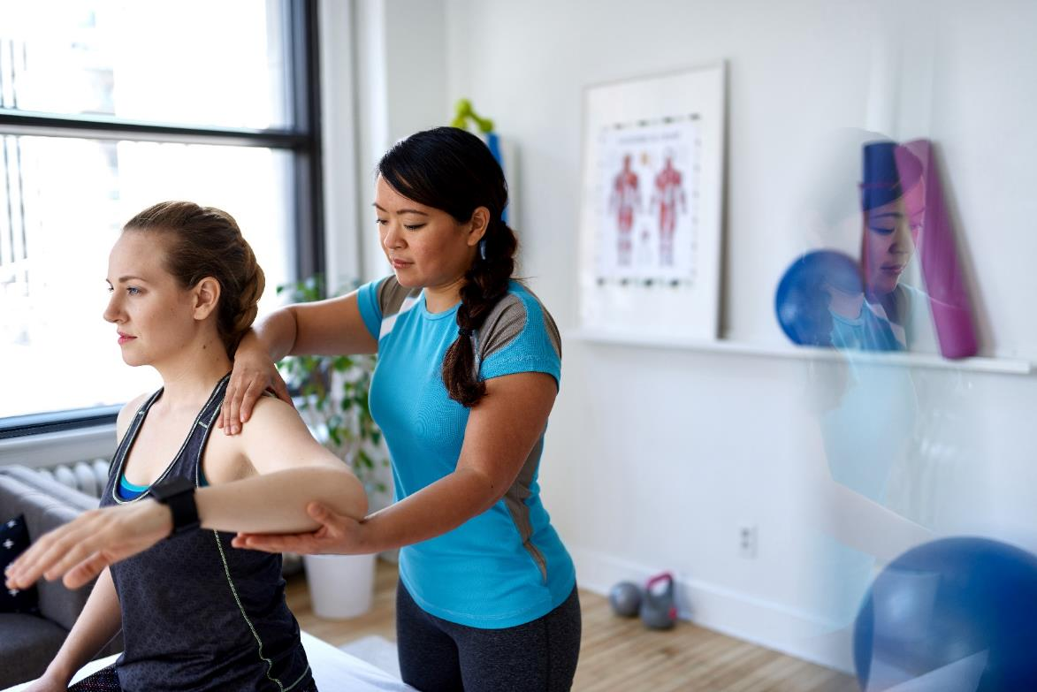
Therapy Treatments
Claim 100% cost, up to set limits, over a 1 year benefit period
Claim money back for any one or combination of the following treatments, up to set limits:
Physiotherapy
Acupuncture
Chiropractic
Homeopathy
Osteopathy

Slide 15

Chiropody
Claim 100% cost, up to set limits, over a 1 year benefit period
Helps cover the cost of treatment and advice provided by a qualified Chiropodist/Podiatrist.
Claim for issues including:
Toenail problems
Verrucas, corns and calluses
Athlete's foot
Dry and cracked heels
Bunions
Or just general advice

Slide 16

Health Screening/ Assessment
Cash back, up to set limits, towards the costs of a detailed assessment of your health. The test must include:
Body composition measurement including height, weight (BMI) and body fat percentage
Blood pressure measurement
Cholesterol or diabetes check
Kidney or liver function test
And it must be carried out by a registered doctor, nurse or pharmacist.
Claim 100% cost, up to set limits, over a 1 year benefit period

Slide 17

Prescription charges
Covers NHS/private prescription charges at the current NHS rate, up to the limits of your plan.
Complete a claim form and enclose the relevant original receipt showing your name and the name and address of the dispensing practitioner.
Available over a 1 year benefit period

Slide 18
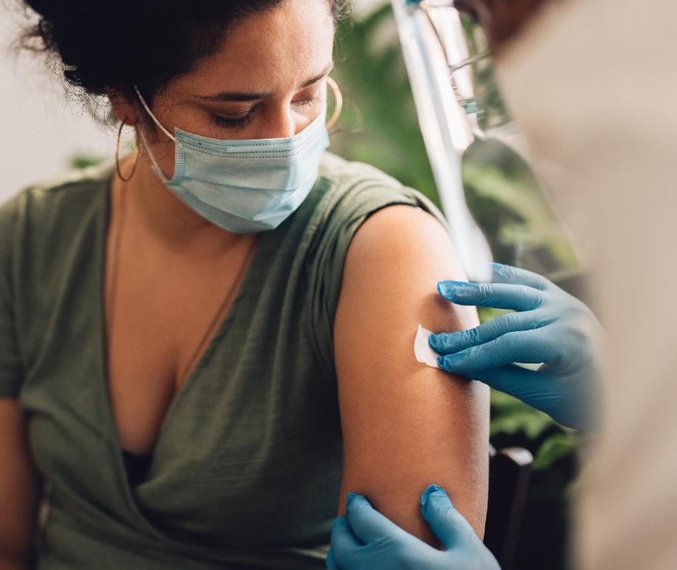
Flu Jabs
Available over a 1 year benefit period
We’ll cover 100% of the cost, up to £15, for 1 flu vaccination per year.
The injection must be carried out by medically qualified staff.

Slide 19




Westfield Rewards
Available on all levels
Helping your money go further.
Discounts and offers at hundreds of leading online and high street retailers, restaurants and destinations
Offers change regularly so please check the website or ‘Smart Spending’ mobile app for the latest discounts
www.westfieldrewards.co.uk
Please note, offers are subject to change.

Slide 20

In-patient
Receive an allowance for each night of stay in hospital, up to a maximum of 20 nights in a one year benefit period.
This benefit covers NHS or private hospitals and registered treatment centres.
Cash payout, up to set limits, over a 1 year benefit period

Slide 21
Day Surgery
Receive a fixed cash payout during a stay in hospital:
At a daily rate, up to a maximum of 10 days in a one year benefit period
When admitted as a day case patient at an NHS or private hospital, or registered treatment centre.
Cash payout, up to set limits, over a 1 year benefit period

Slide 22

Maternity / Paternity / Adoption
Cash payout, up to set limits, over a 1 year benefit period
The plan gives you a payout on the birth of your child, or when a child joins your family through adoption.
This benefit has a 10 month waiting period before you can claim.

Slide 23

24 Hour Advice and Information Line and online resources
Freephone telephone access to confidential guidance on medical, legal or domestic issues from qualified counsellors, legal advisors and nurses
Access to the Wisdom app with online resources, designed to support your health and wellbeing
Call the freephone line 24/7

Slide 24
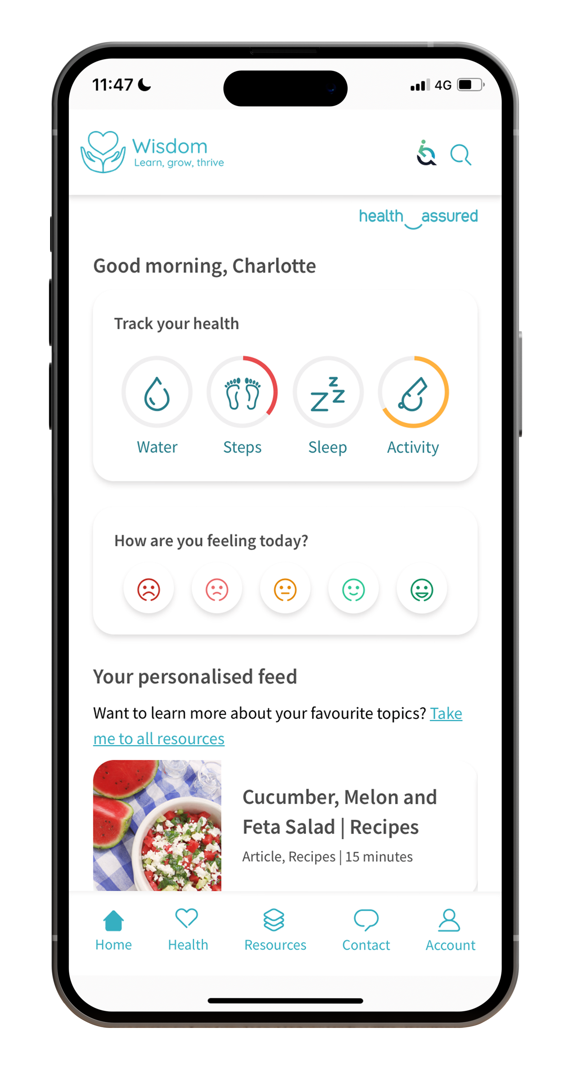
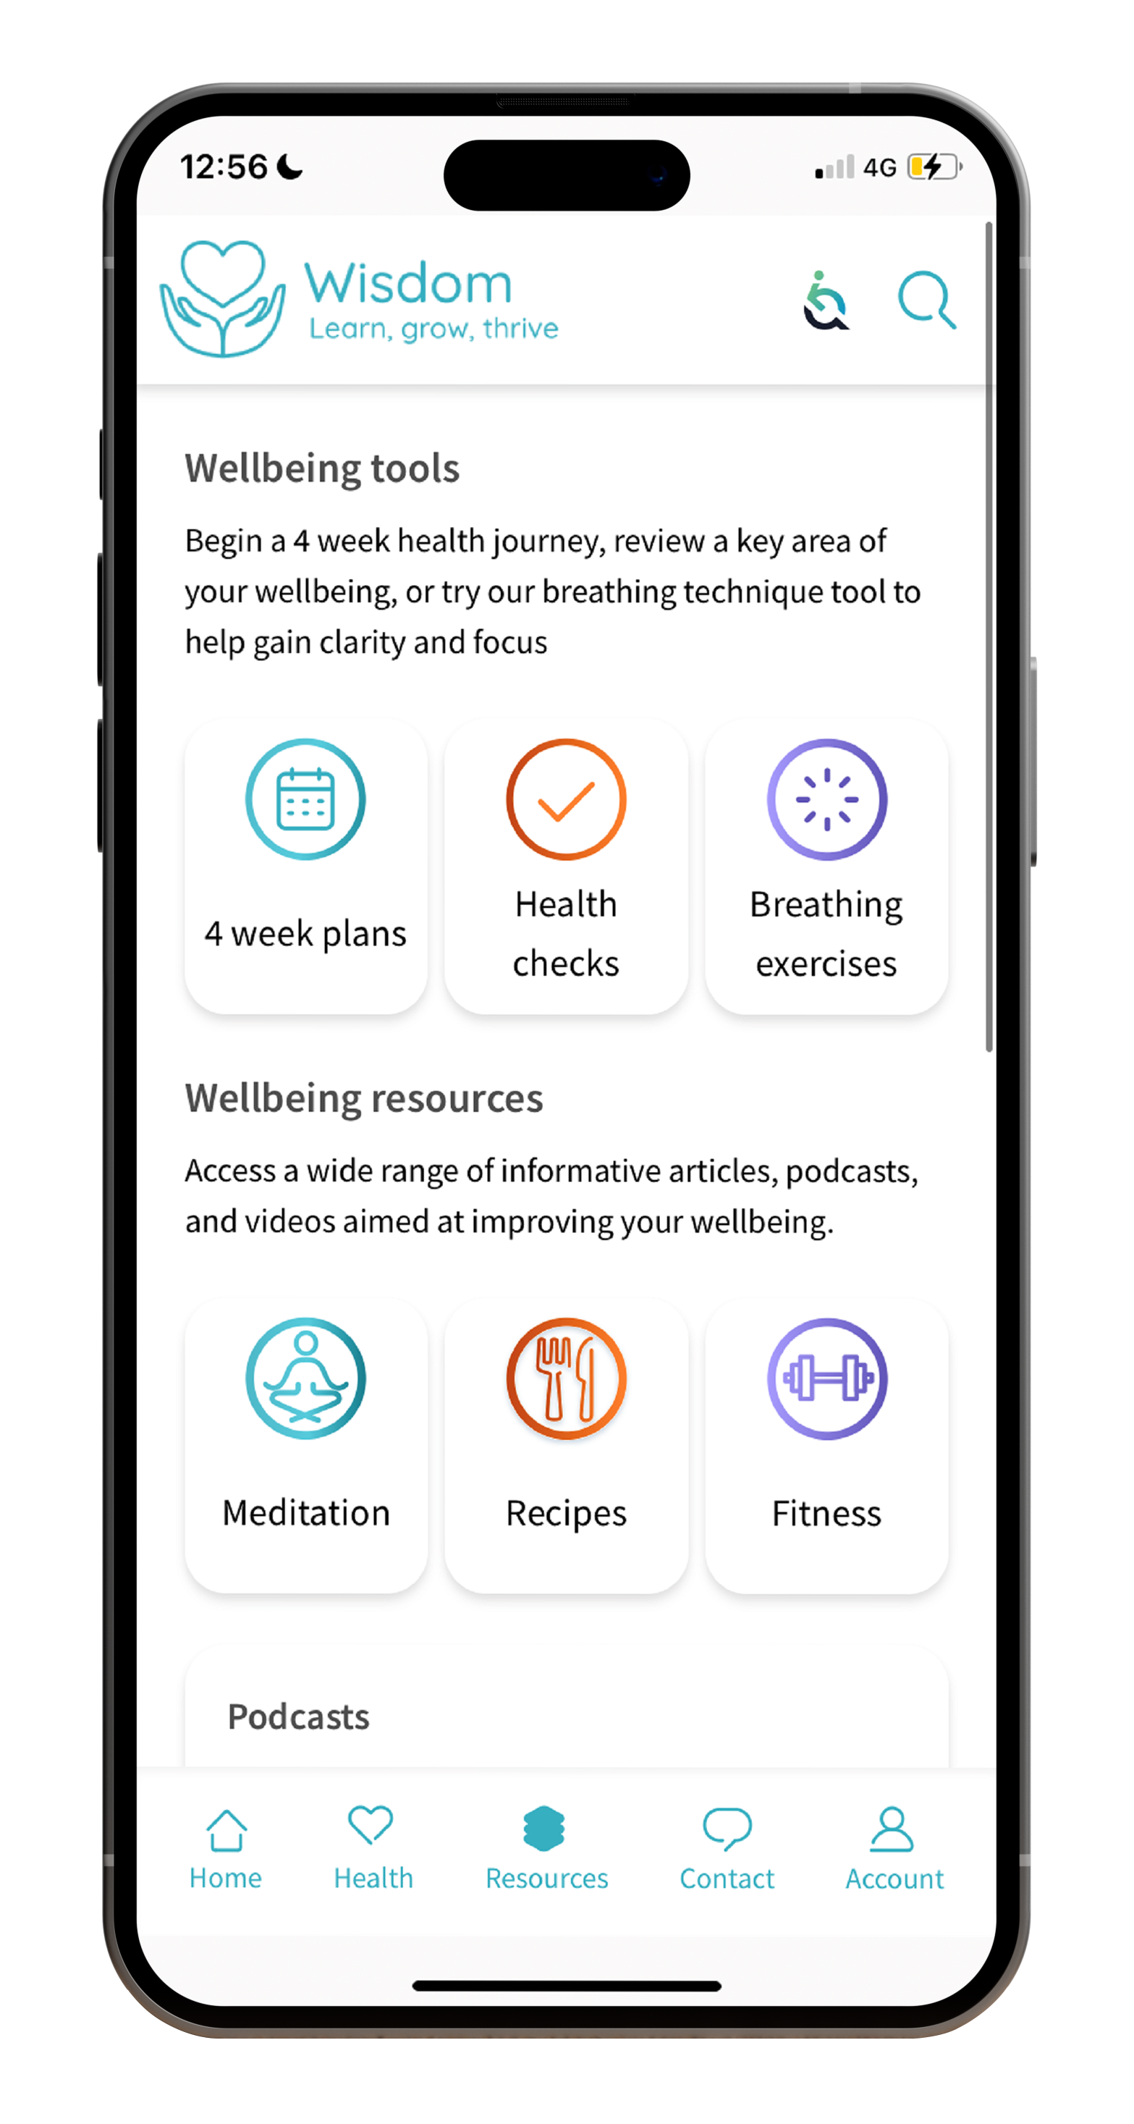
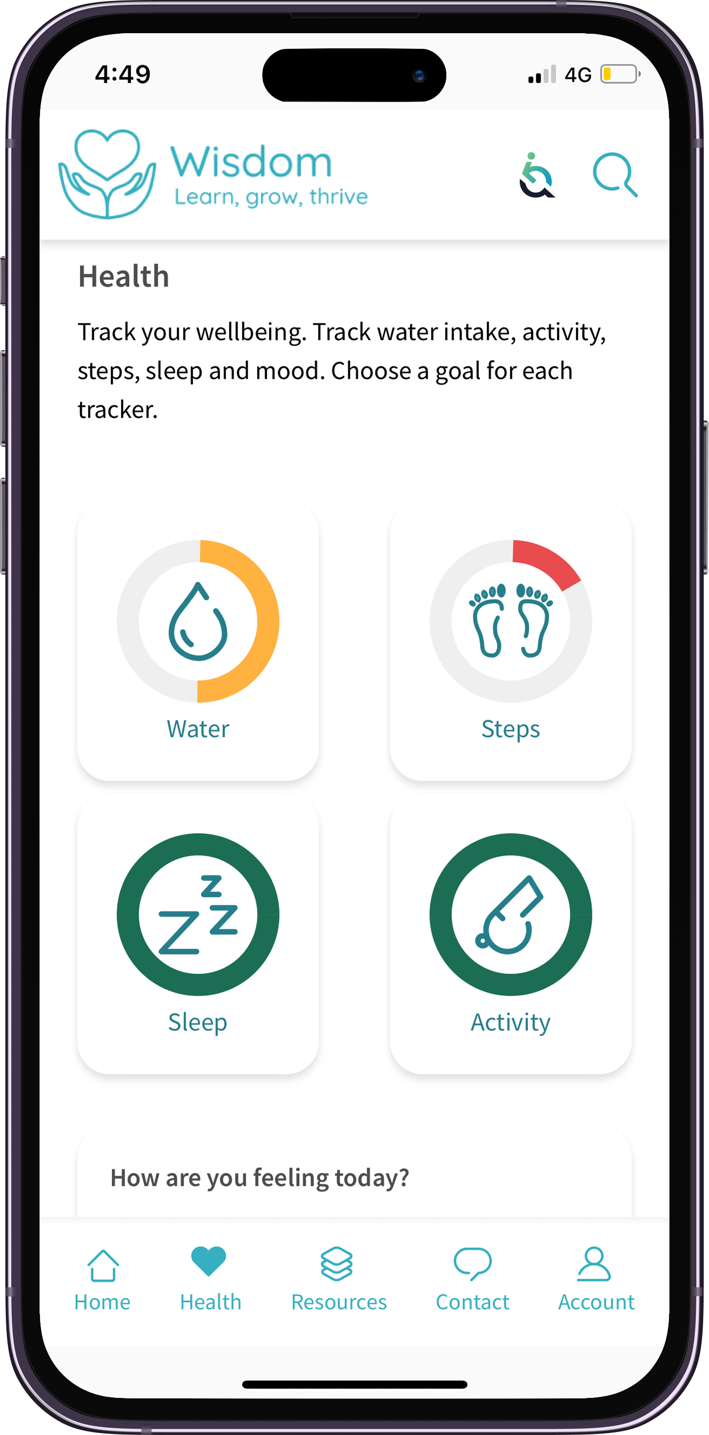
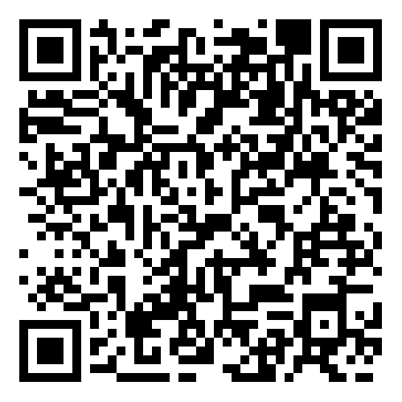
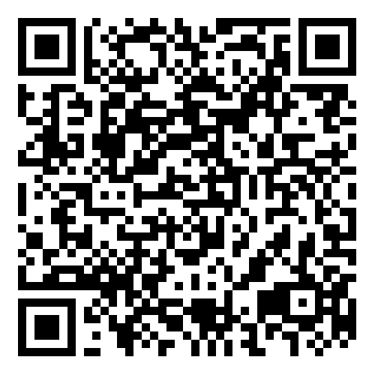

Wisdom
The Wisdom app gives you access to a range of interactive tools and features, helping you track your wellness, improve your mental health and stay resilient during tough times, including:
Live chat and support
Personalised homepage
Interactive mood tracker
Wellbeing trackers
Four-week health plans
Mini health checks
Breathing techniques

Slide 25
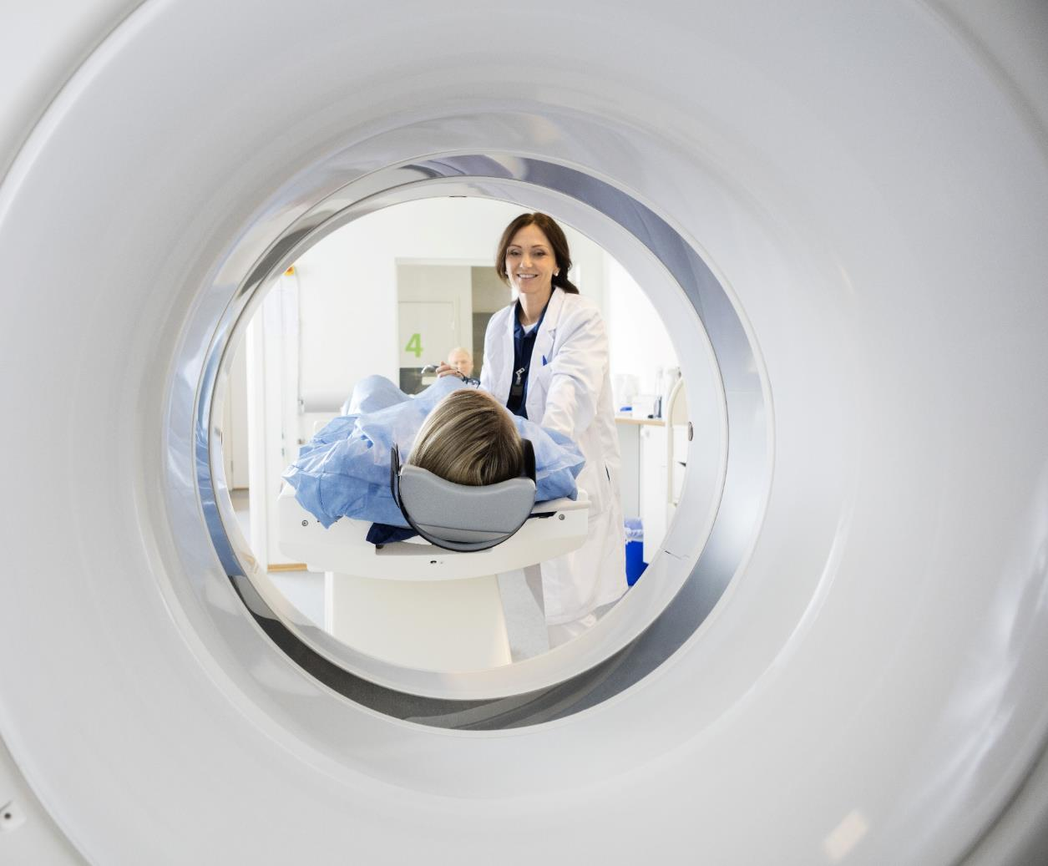
Scanning Service
Quick access to high quality MRI, CT and PET scans for fast diagnosis:
Choose the location and time
You'll be looked after by our professional team
MRI and CT scans are unlimited
PET scans are limited to one per 12 month period
Call the scanning helpline following a referral from your consultant

Slide 26
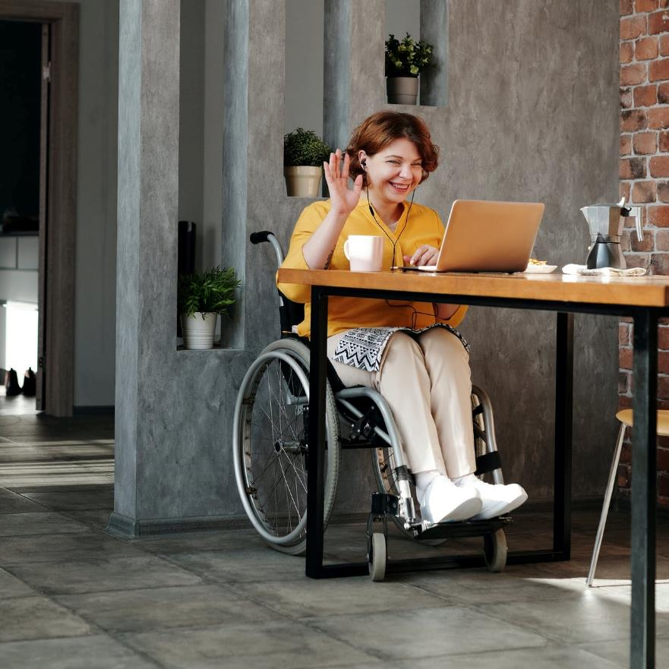
DoctorLine
Unlimited 24/7 telephone access to qualified practising UK GPs:
Call worldwide
Webcam appointments available
Arrange appointments and access health and wellbeing advice through the web app
Have prescription medicines sent to your home, workplace or a nearby pharmacy
Available on all levels

Slide 27

Gym Discounts
Discounts at gyms and health clubs in your area, as well as online classes
Current gym members may transfer their existing membership
Offers are updated regularly
Get fit and actively start improving your health!
Available on all levels

Slide 28
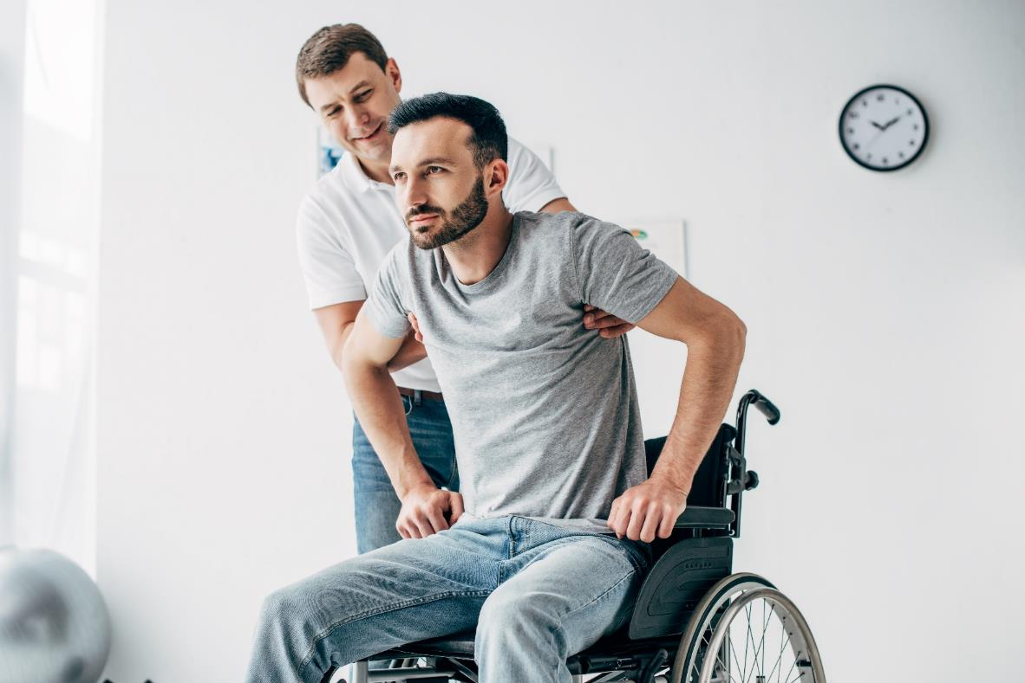
Personal Accident
Receive a cash payout
Cash payouts to help you and your family if the worst should happen.
Accidental bodily injury that causes your death within 24 months of the time of your accident
Accidental bodily injury that causes your permanent disability within 24 months of the time of your accident

Slide 29

Kids cover
You can claim for your kids up to their 22nd Birthday.
These benefit limits are shared between all your dependent children:
Optical
Dental
Dental Accident
Specialist Consultation and Diagnostics
Therapy Treatments
Cash payout for each child:
In-patient - per night, up to 20 nights per year
Day Surgery - per day, up to 10 days per year
Available, up to set limits, on all levels

Slide 30




My Westfield
My Westfield is available to all employees:
Make a claim
View plan documents
Manage account
Access health and wellbeing services
westfieldhealth.com/my-westfield
Download the mobile app on the Apple App Store or Google Play

Slide 31

Thank you
Westfield House
60 Charter Row
Sheffield
S1 3FZ
0114 250 2000
www.westfieldhealth.com
Westfield Contributory Health Scheme Ltd (company number 303523), Westfield Health & Wellbeing Ltd (company number 9871093) and Westfield Employment Services Ltd (company number 9870326) are collectively referred to as Westfield Health and are registered in England & Wales. Additionally Westfield Contributory Health Scheme Ltd is authorised by the Prudential Regulation Authority and regulated by the Financial Conduct Authority and the Prudential Regulation Authority. Our financial services registration number is 202609.

